Slide 1

Once at Christmas time…
Andrii Savchin

Slide 2
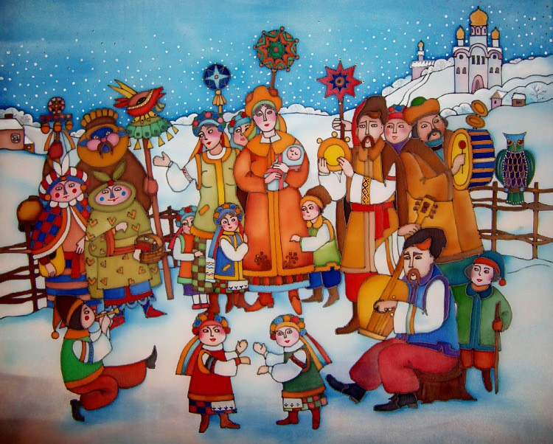
One day at Christmas, the nativity scene visited us. The nativity scene is a fun Christmas event with performances, jokes, carols arranged by local residents.

Slide 3
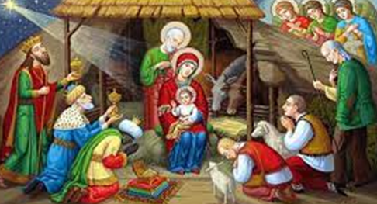
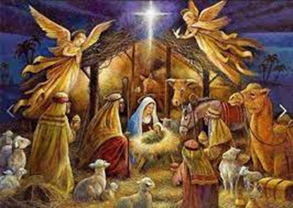
The main heroes of the nativity scene are the kings and three shepherds who rushed to the newborn Jesus, bringing him gold, frankincense and myrrh

Slide 4
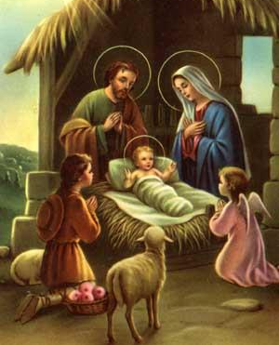
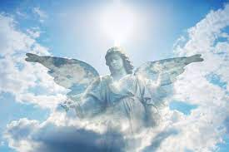
One of the main characters was the Angel who announced the birth of the Messiah.

Slide 5
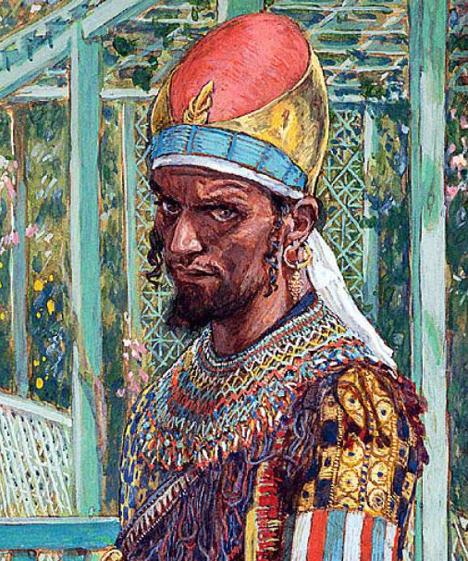
Evil Herod was looking for a newborn child and wanted to kill him.

Slide 6

The funniest scenes in the nativity scene were the death of Herod, the participation of such characters as the devil, the gypsy and the jew.

Slide 7
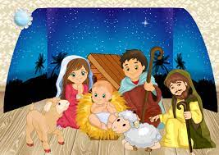
Today, Christmas traditions are declining.

Slide 8


