Slide 1
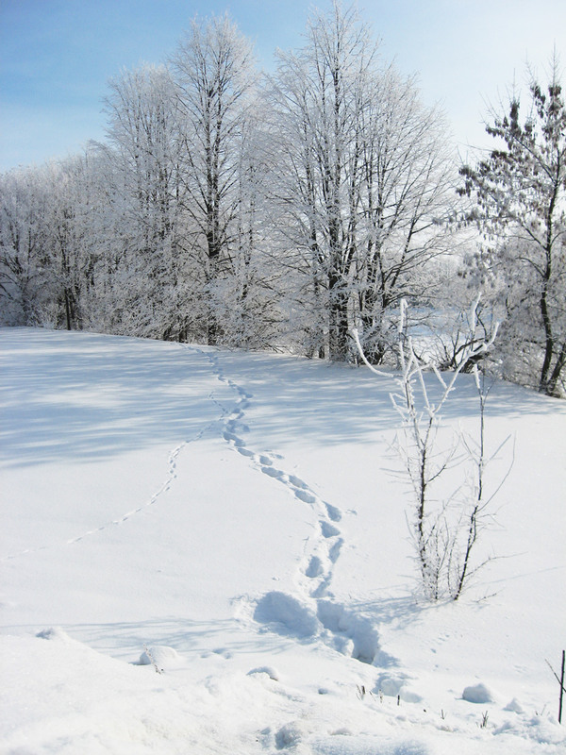
One Christmas morning, I woke up in the morning. I washed, brushed my teeth and went to play games on the phone. After some time, my friend Denys called me. We decided to go skiing. I dressed warmly and went to his place. We took the skis and went to hill. We skied for a long time. It was fun. I offered to go to the forest to ski there. When we entered the forest, we saw small and strange tracks.

Slide 2
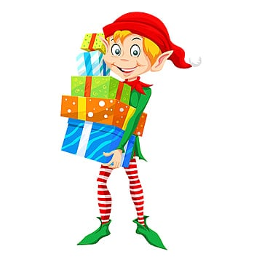
They led into the deep forest. We decided to follow the tracks and find out who it's like that. Once I noticed a small man, it was probably an elf. We started following him. We saw how he went into a very beautiful house. Denis and I thought for a long time about what to do. And we decided to go into this house. When we went there, we saw a lot of presents. We also saw a real elf. He was singing something to himself and didn't see us. And then I woke up. Unfortunately, it was a dream.

