Slide 1

Books are our friends

Slide 2
Answer the questions:
Who was the author of the famous storybook «Alice’s Adventures in Wonderland»?
How many lines does a sonnet have?
What is the name of the first book of Harry Potter?
Who wrote the crime novel «Ten Little Indians»?

Slide 3
Vocabulary work
Match the words
with their definitions

Slide 4
Wealthy the capital of France
Involved a private teacher
Poison taking part in something
Paris a story or play about crime
Tutor a substance that can make you die
Mystery rich

Slide 5
Reading
A biography
of Agatha Christie

Slide 6
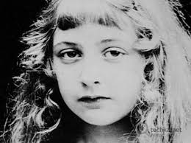
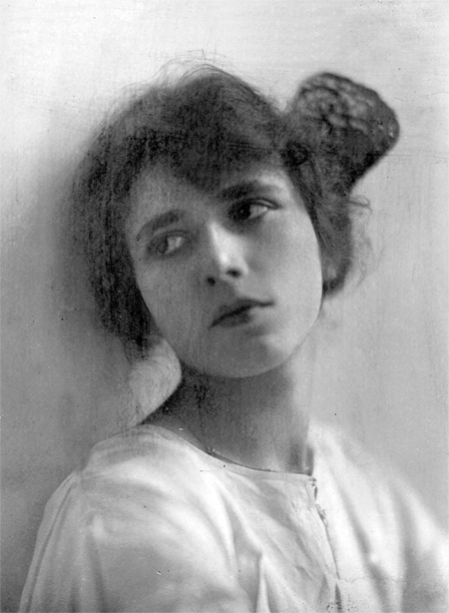

Slide 7
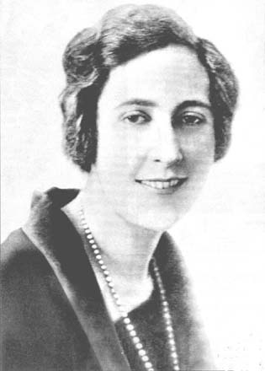
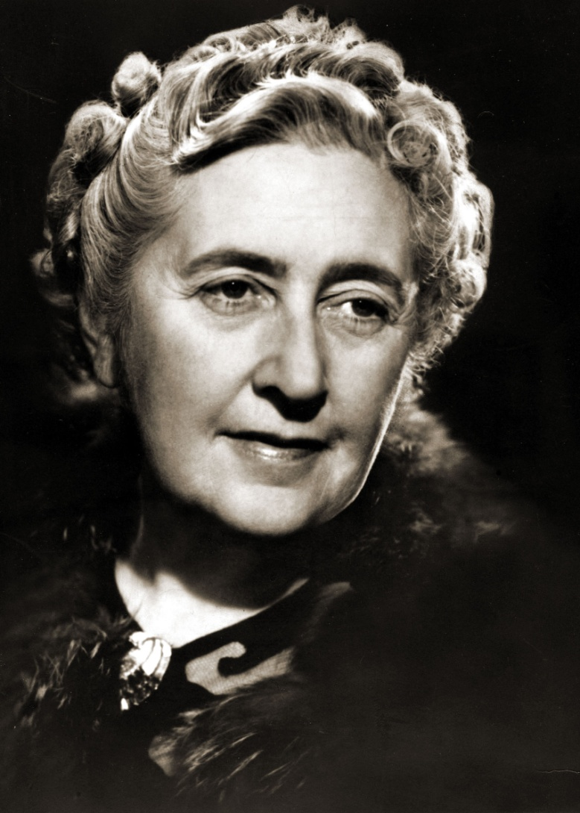

Slide 8
Speaking
When was Agatha Christie born?
Was she an only child?
Did she attend school?
What was she like as a child?
What did she study in Paris?
Who was her first husband?
When did she start writing detective stories?
What happened in 1926?
How did she meet her second husband?
Where did she often travel?
Who were her most popular characters?
How old was she when she died?

Slide 9
Say something about these names
Devon
Archie Christie
Paris
Hercules Poirot
Max Mallowan
The Orient Express
The middle East
Miss Jane Marple

Slide 10
Writing
Fill in the fact file:
Born:
Died:
Family:
Education:
Jobs:
Marriages:
Famous novels:
Famous characters:
Literary work:

Slide 11
Watching

