Slide 1

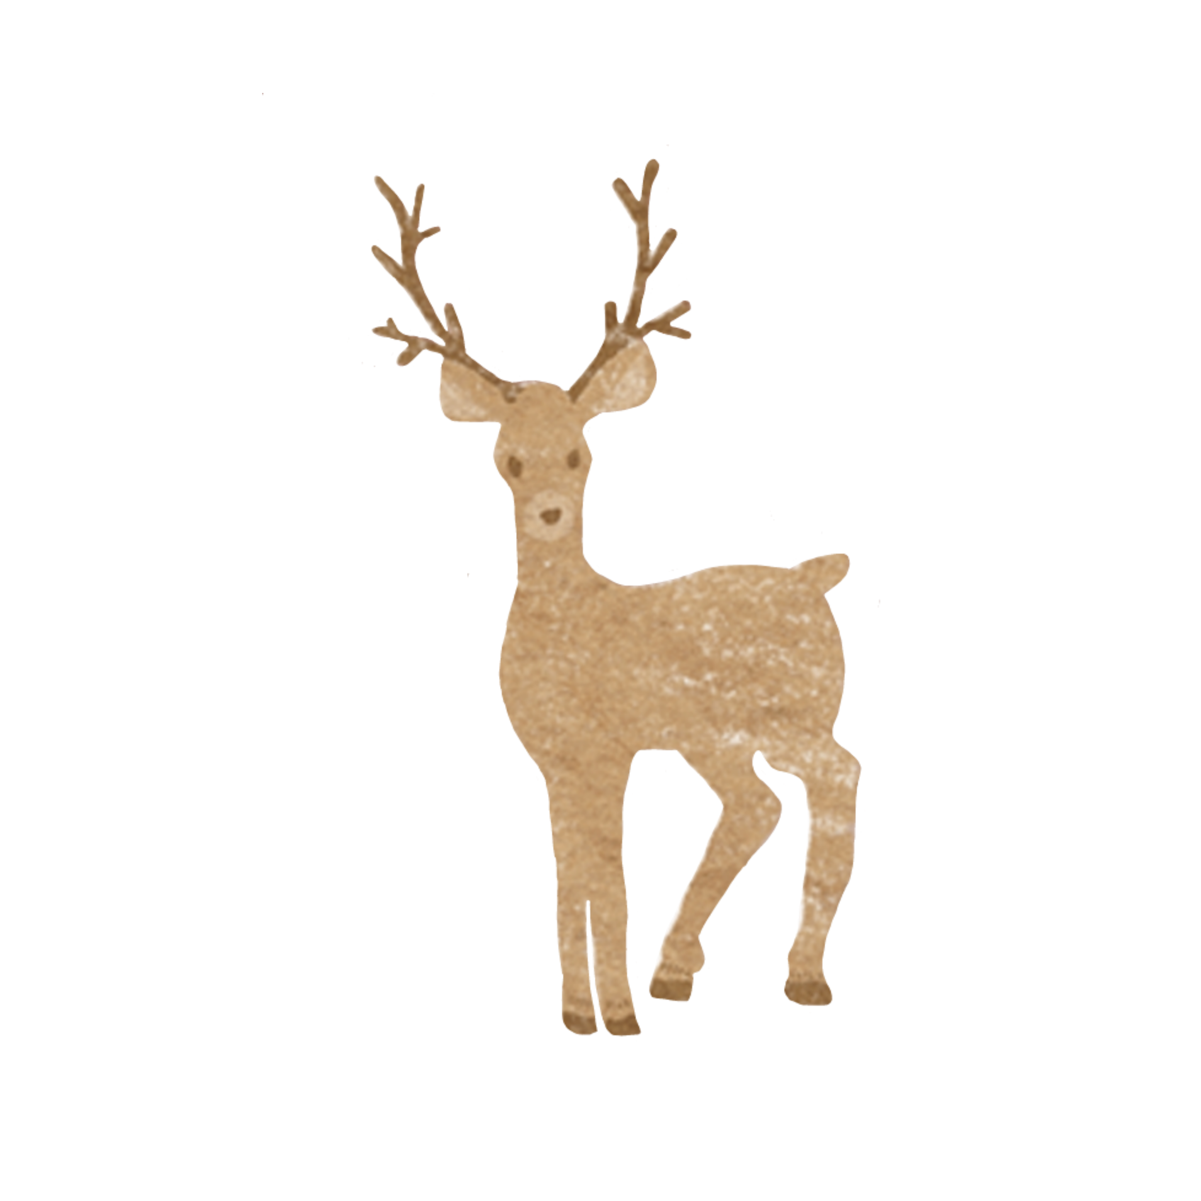


Once at Christmas…

Slide 2

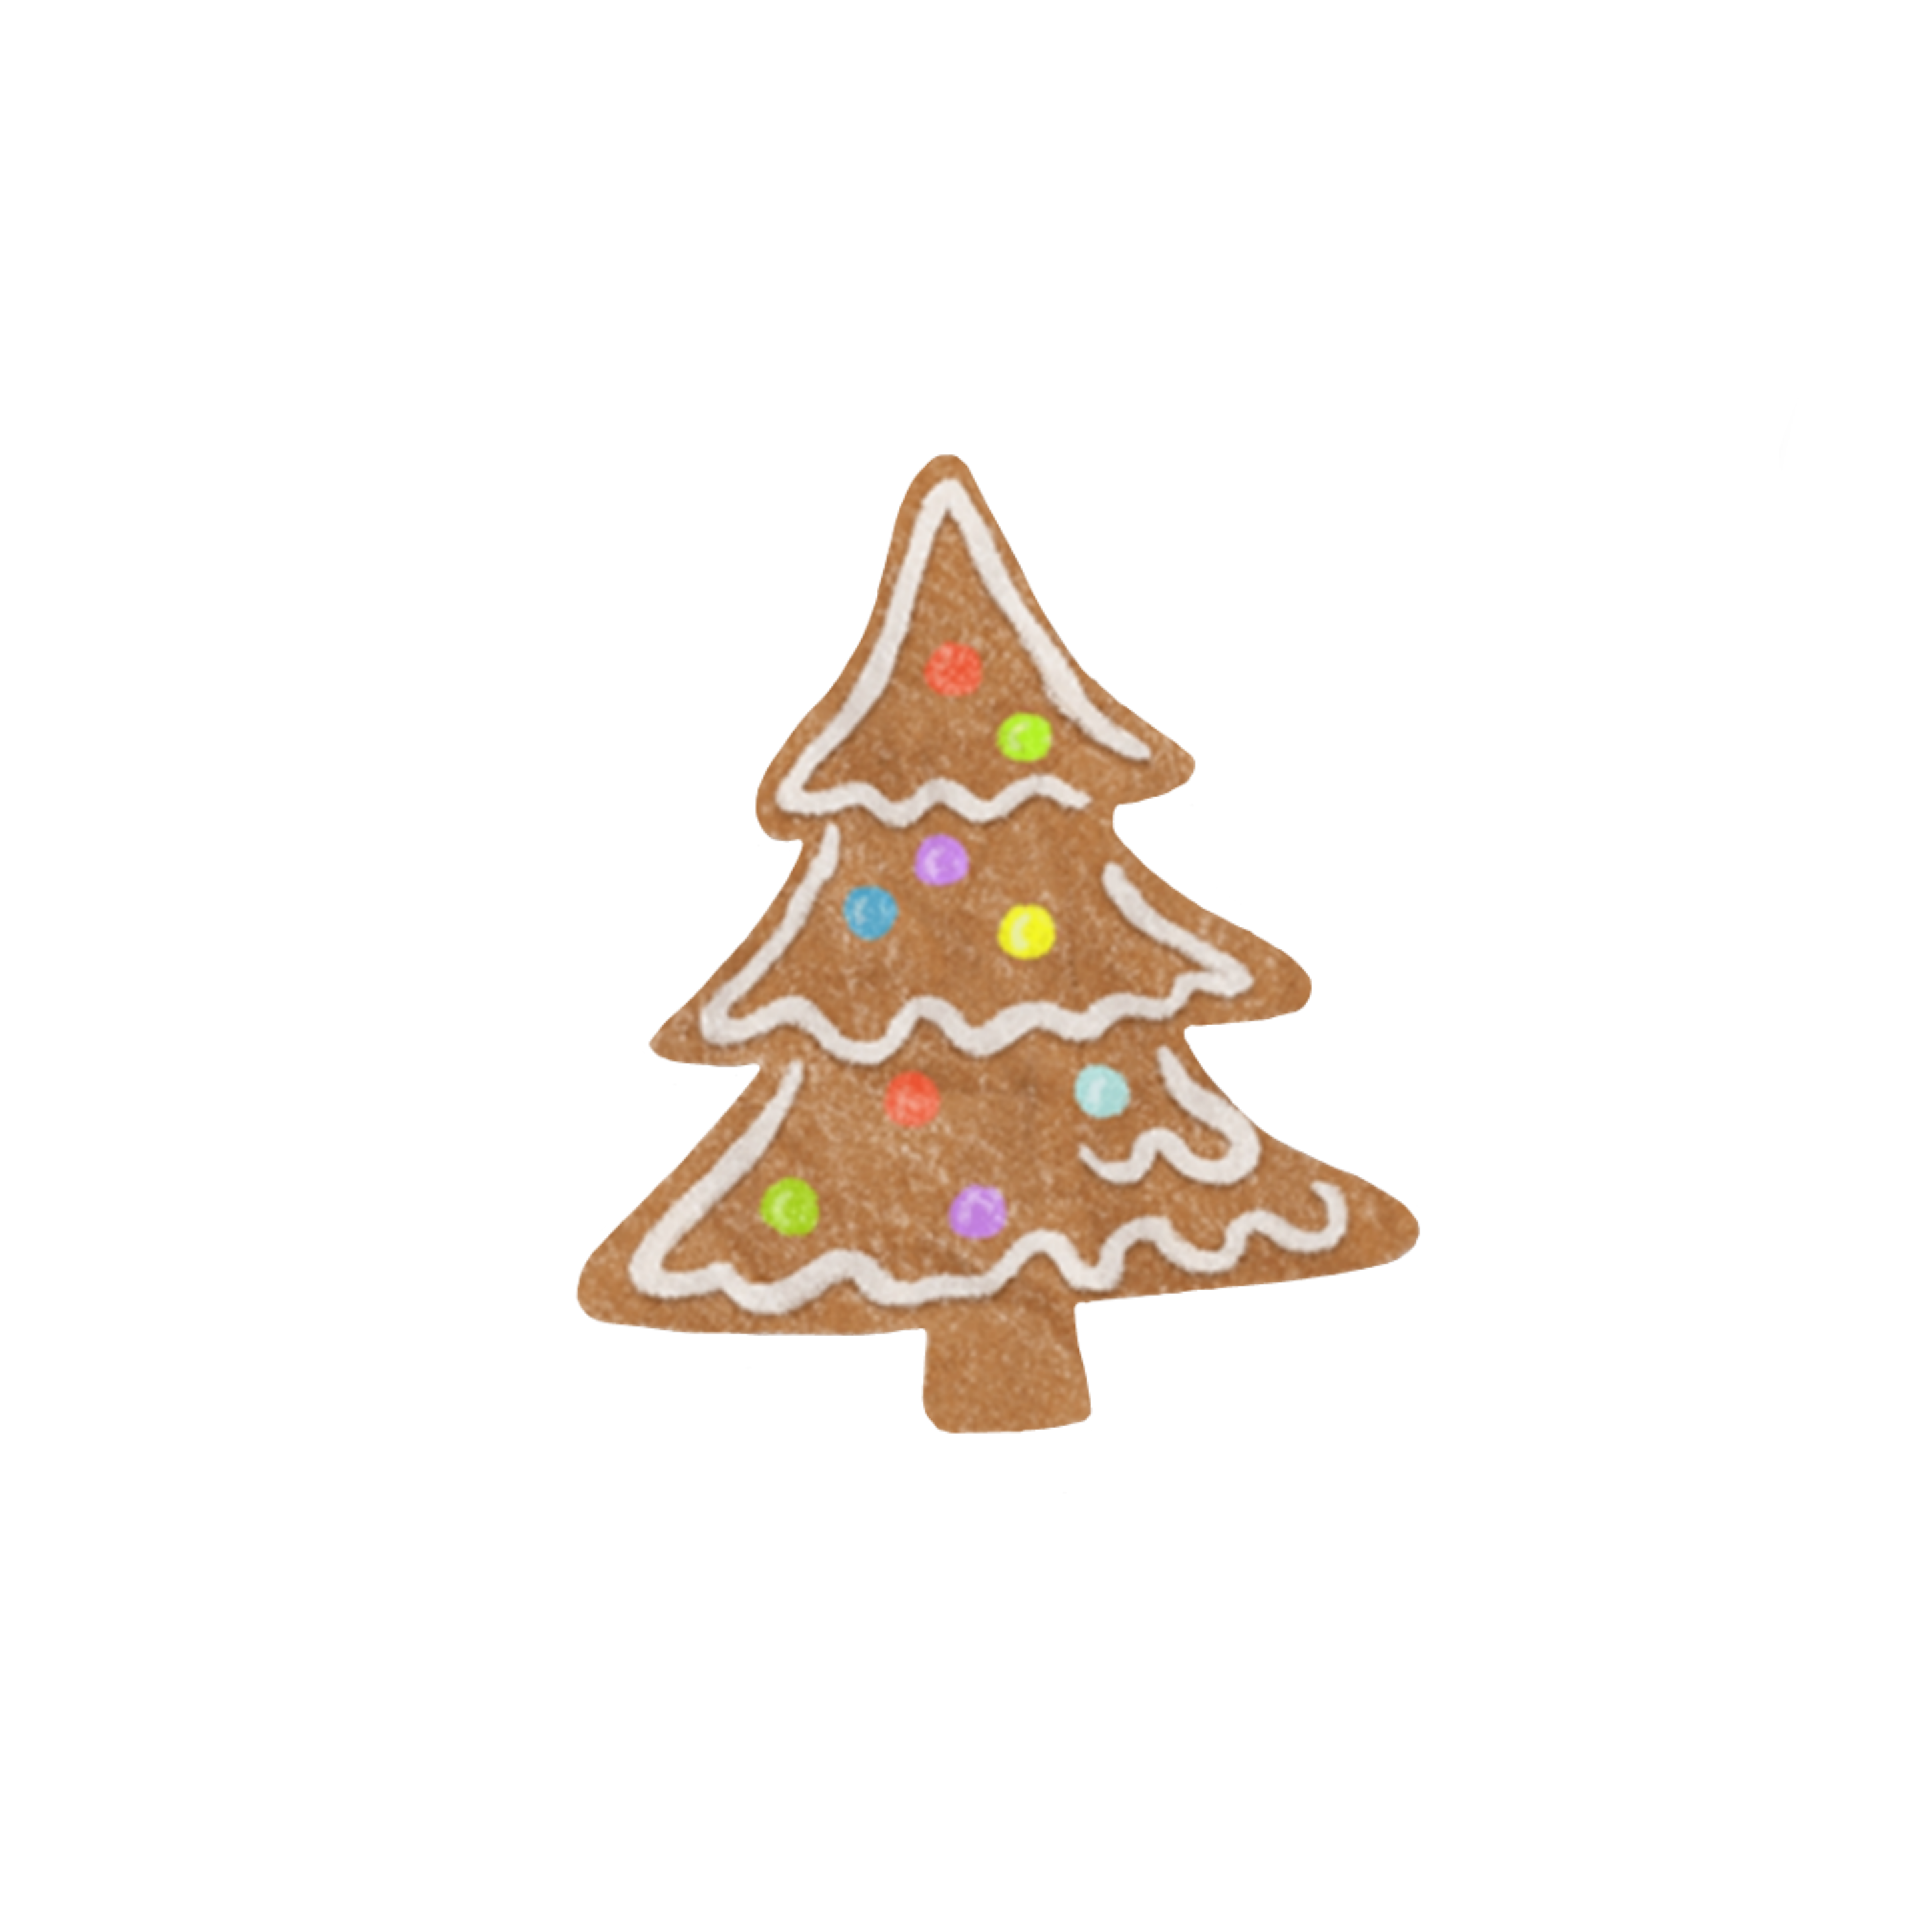
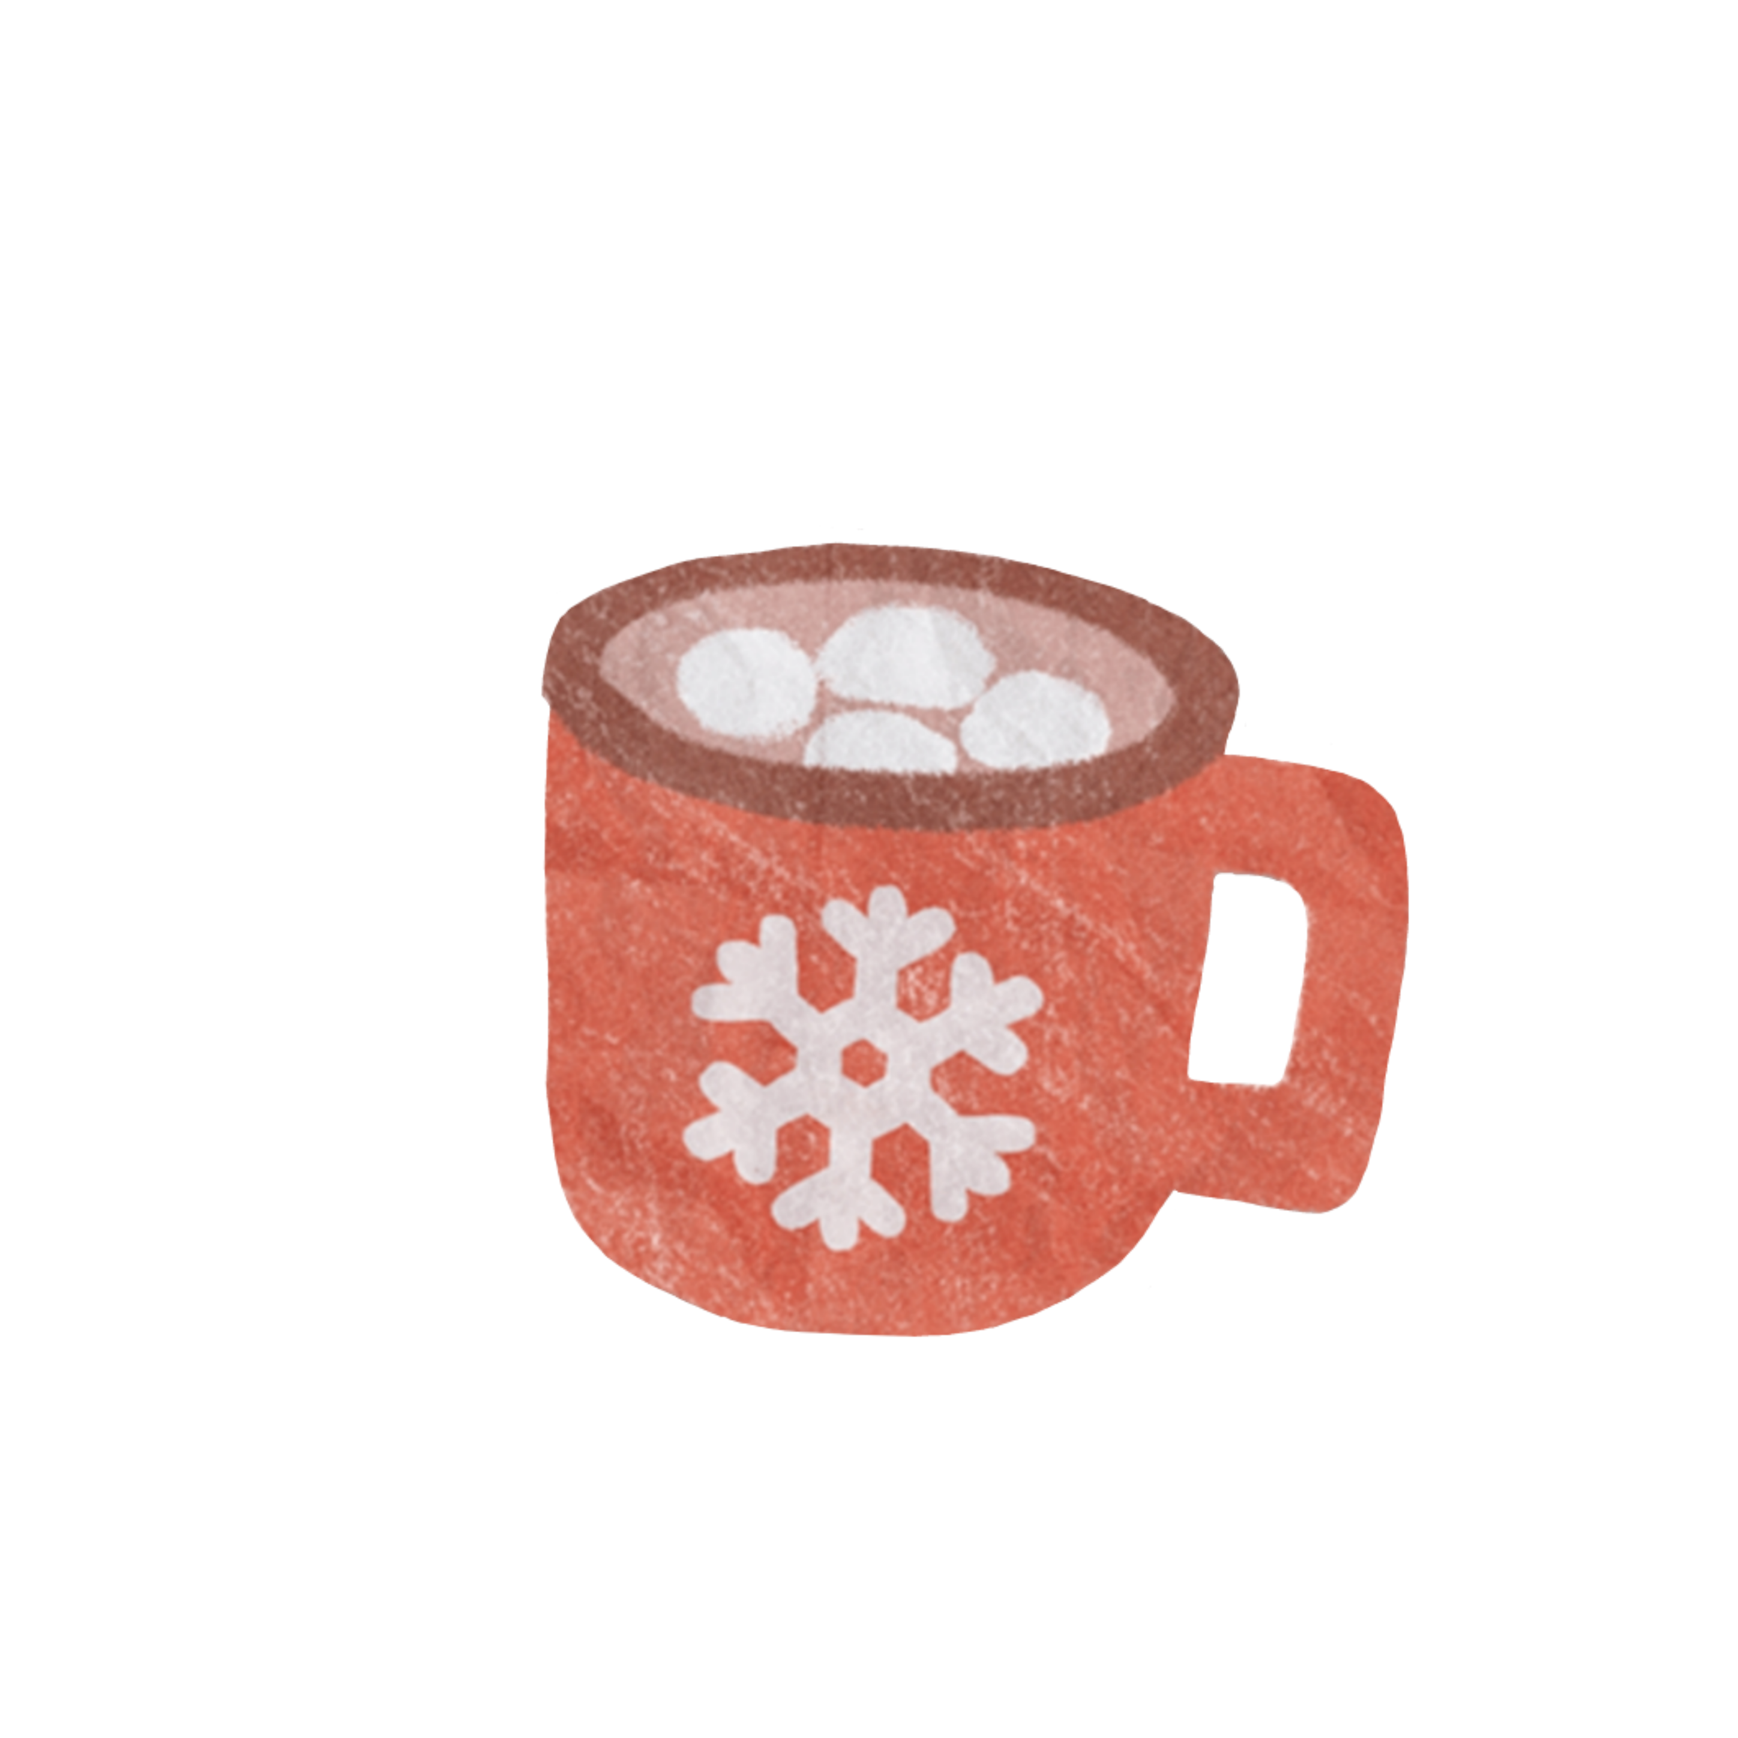
Once at Christmas a miracle happened to me. It was a real happiness to see the whole family at the same table, because Christmas is a special holiday. I always like this holiday. During this time, the weather outside is truly winter. Often the whole earth is covered with snow, which shines in the sun.

Slide 3
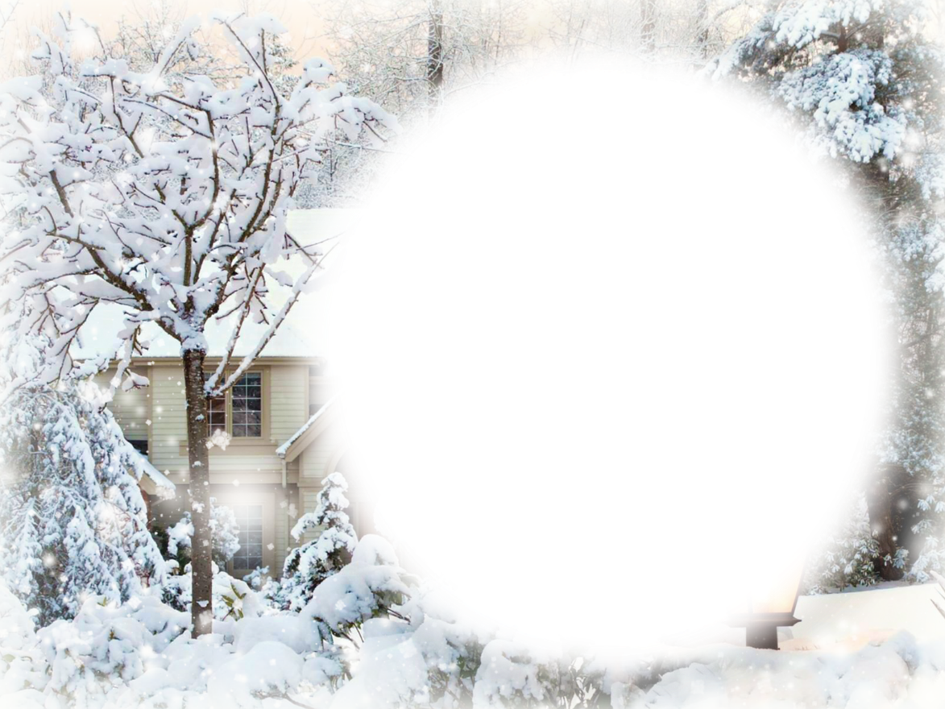
The trees are covered with snow and have an attractive appearance. The trees are covered with snow and have an attractive appearance. Relatives and friends who want to congratulate each other on this holiday of the year gather in the houses. On this day, my mother prepares many delicious meals.

Slide 4


Since before the New Year, we always have a decorated spruce. It gives this holiday a special atmosphere. The whole day before the holiday is filled with anticipation of a miracle. The evening is coming. We pray, sit down at the table and begin the feast.

Slide 5

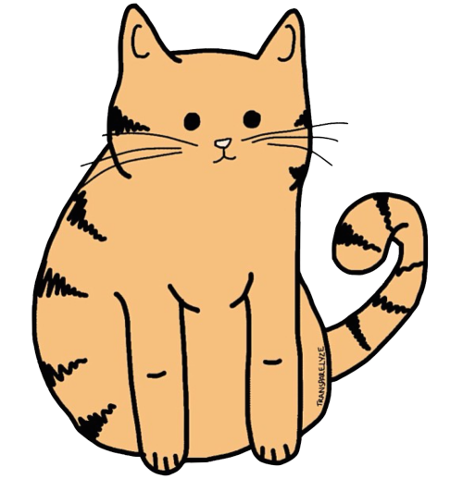
I noticed that our cat was not there. I went outside and saw that he was running somewhere, I started to catch up with him. Suddenly everything darkened and I found myself in another city. Here the creatures looked very interesting, but were sad. Later they noticed me and started asking where I was from. I told them about our world and how I got here.

Slide 6
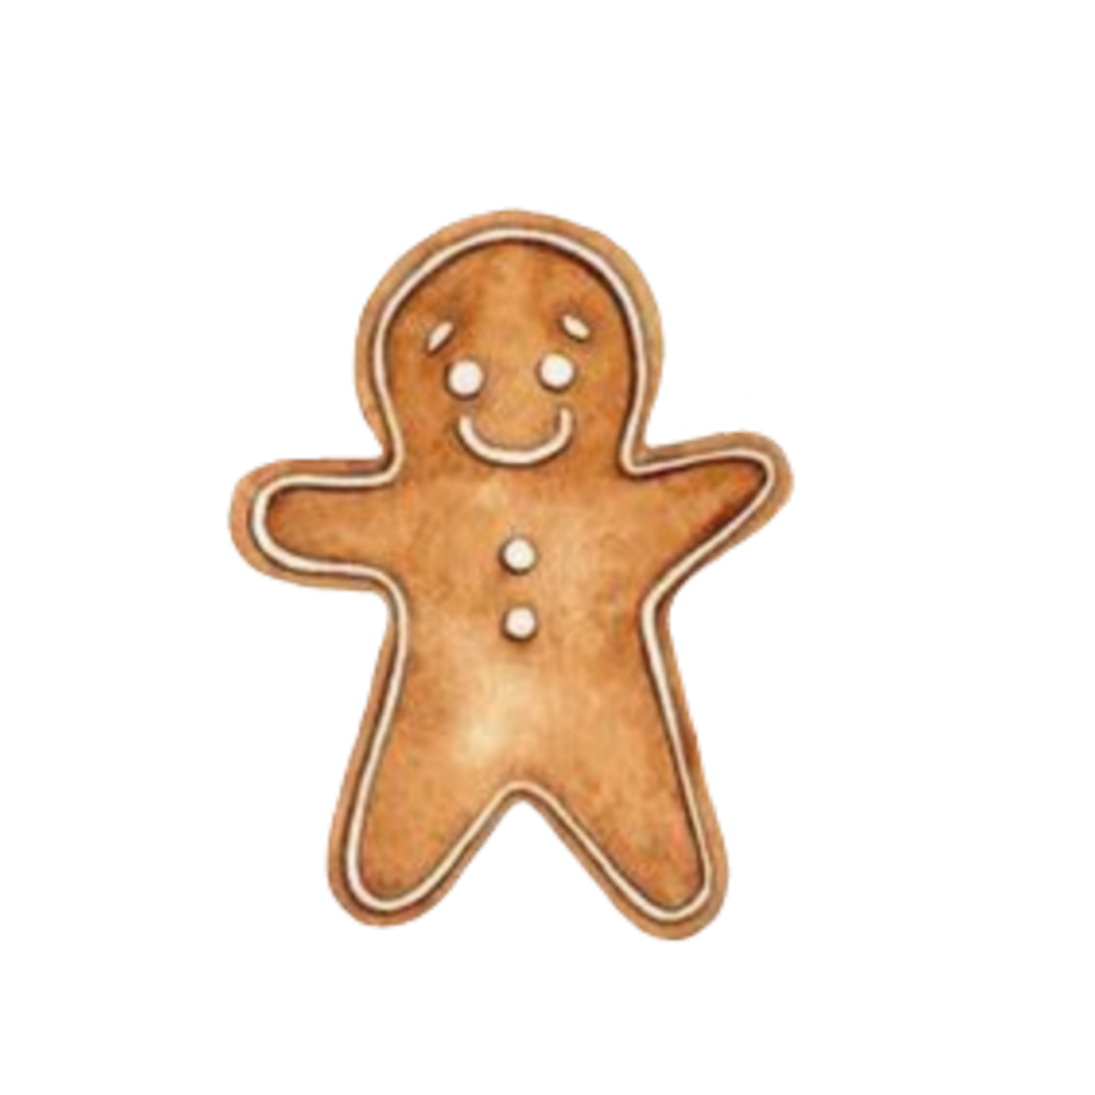
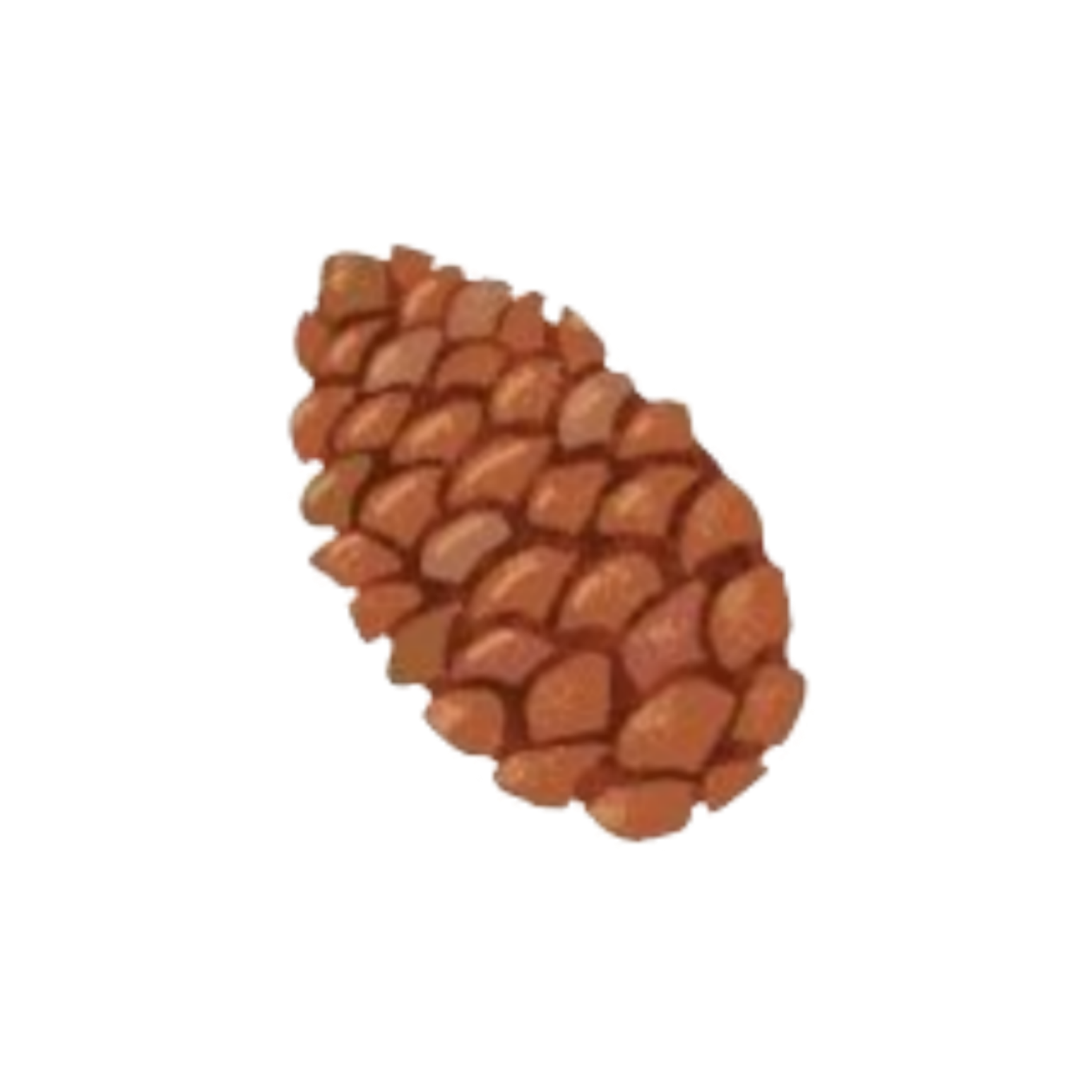

They said that none of the people had been here before and did not understand how this could have happened. I asked them to help me get home, because they are celebrating Christmas today. They asked in surprise what Christmas was and said that it was not customary to celebrate events in their country.

Slide 7
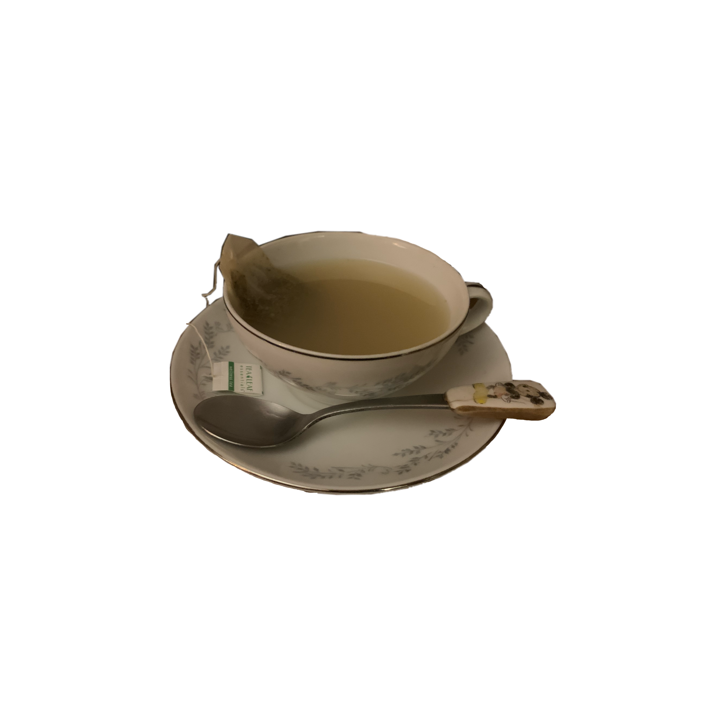
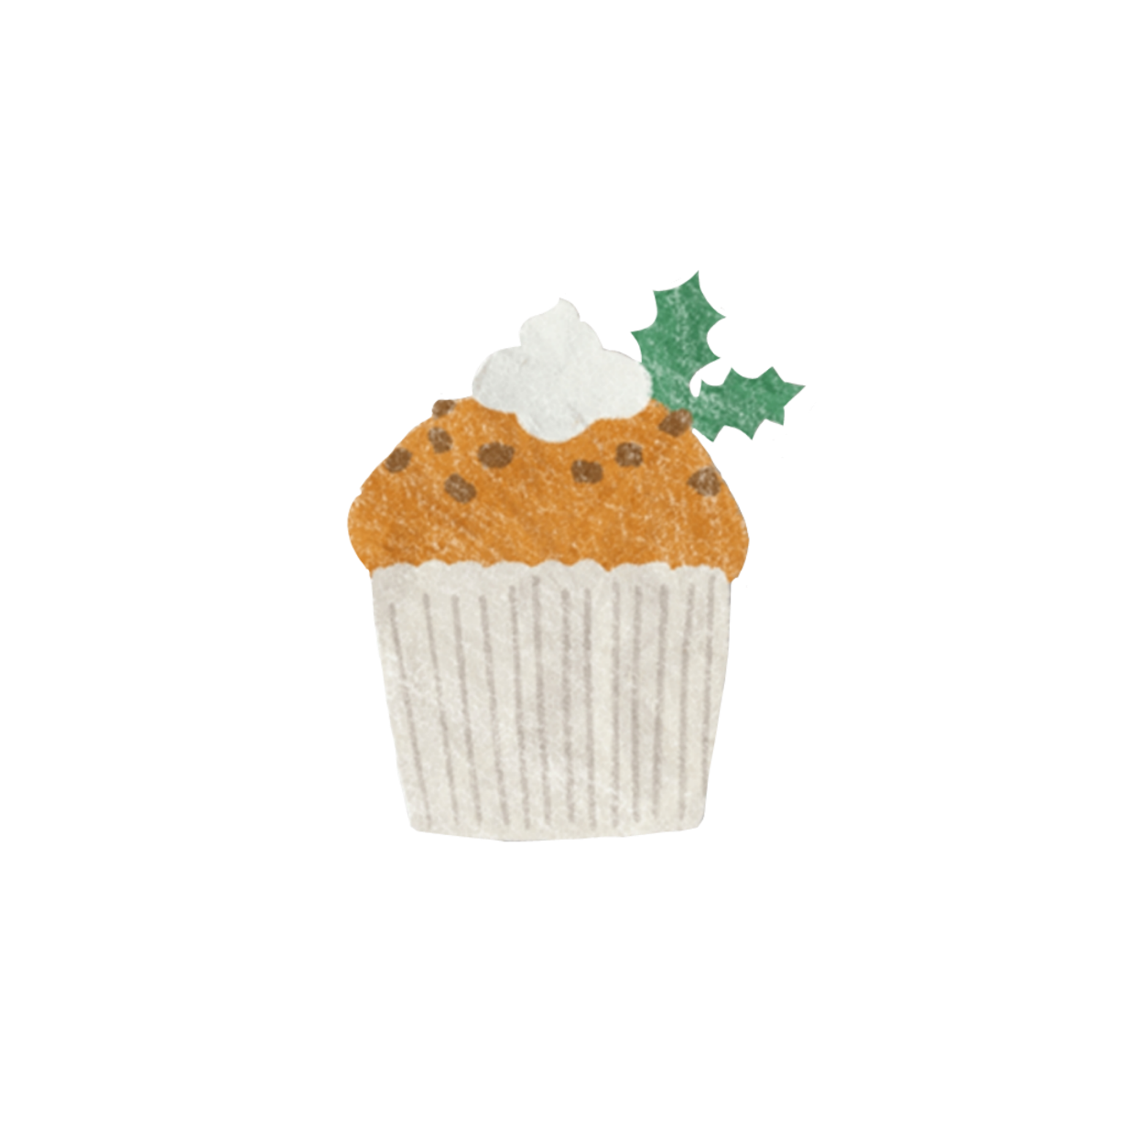
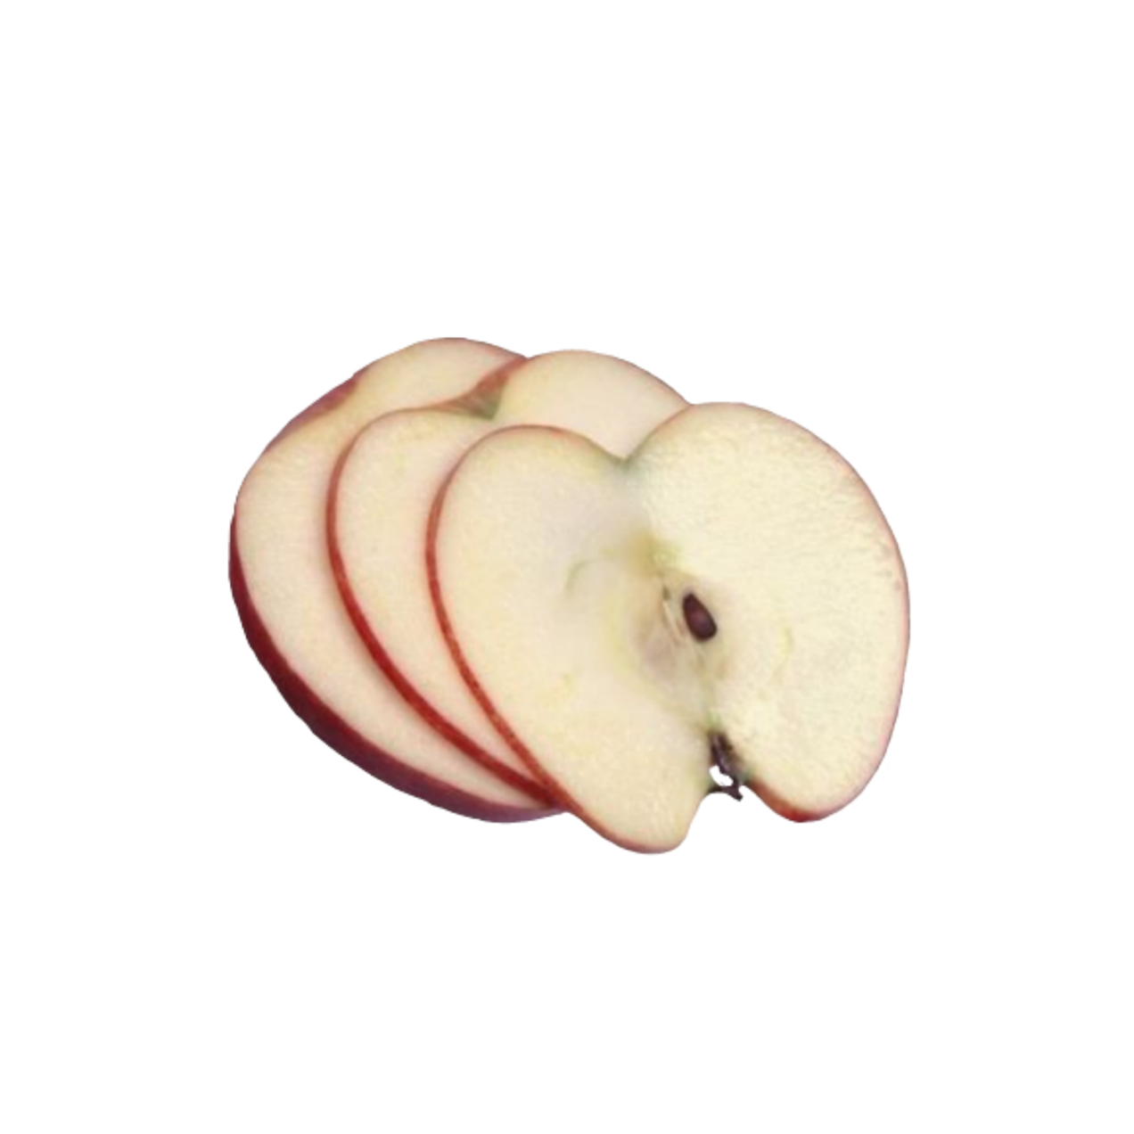
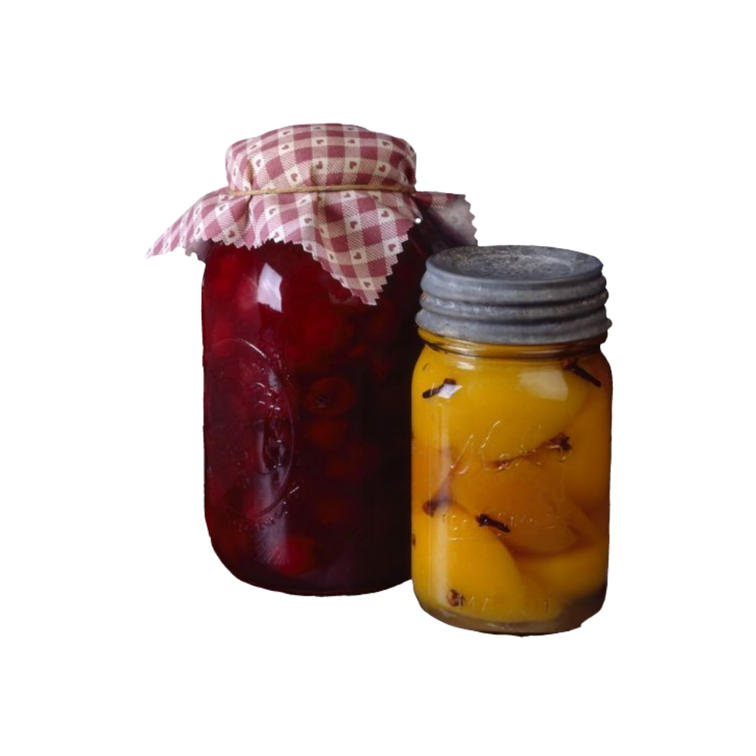
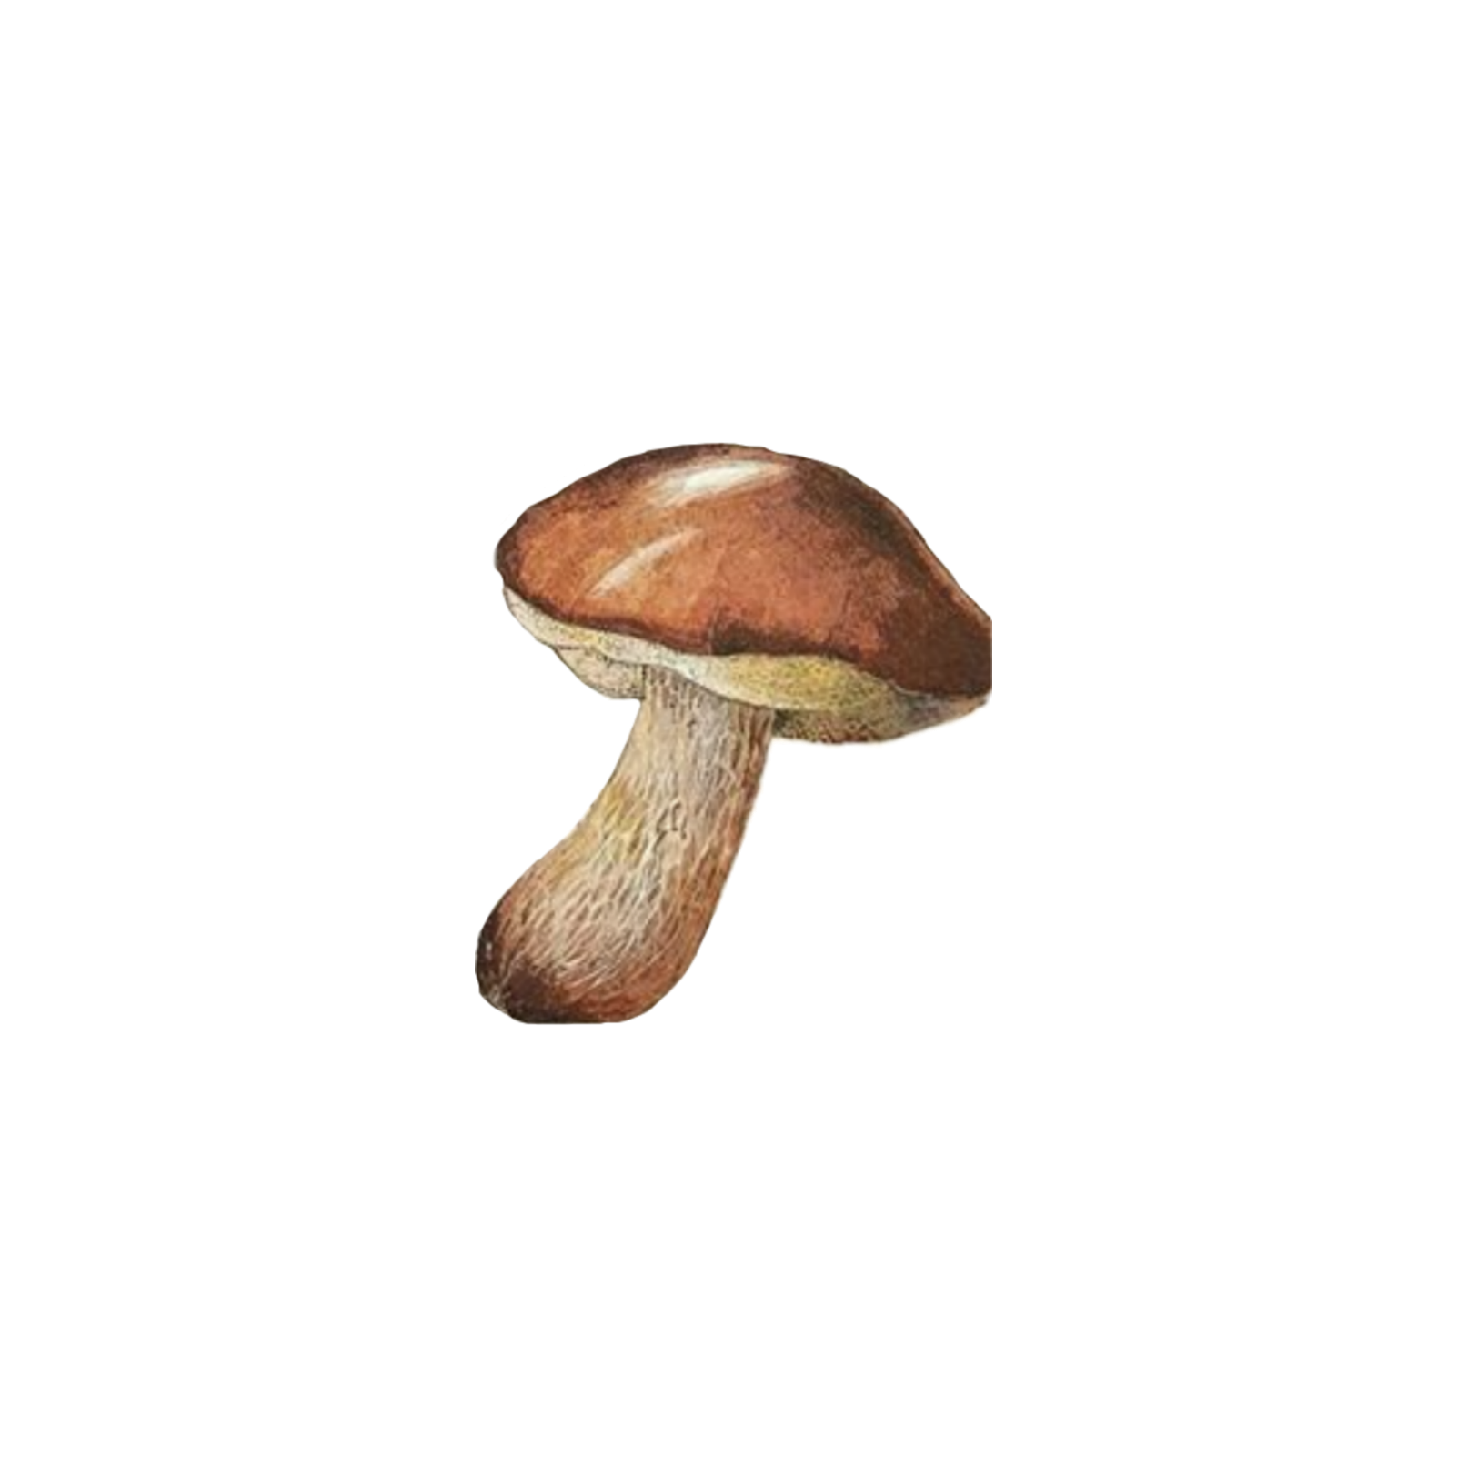
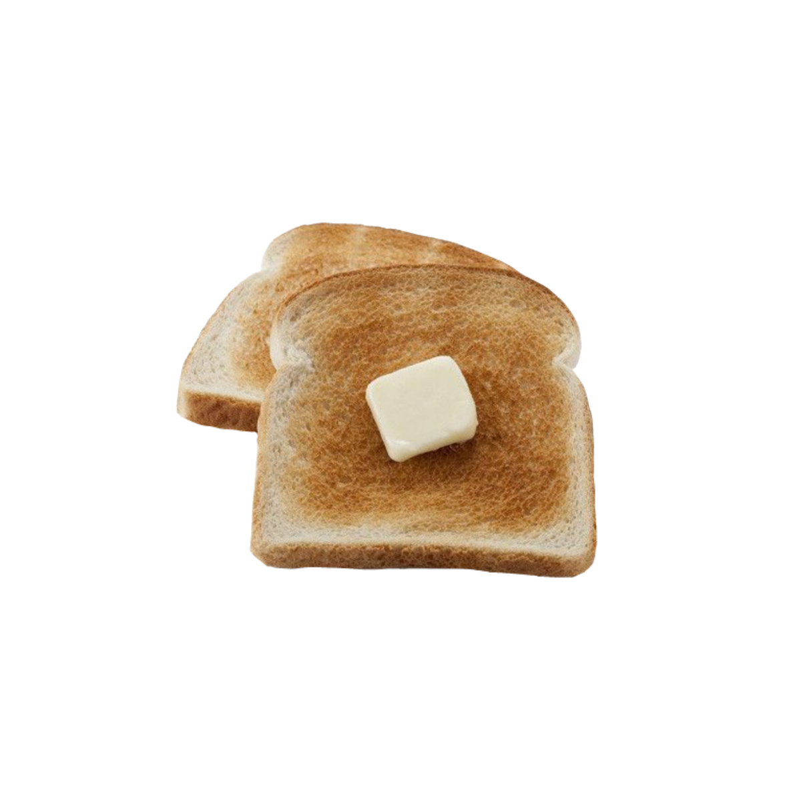
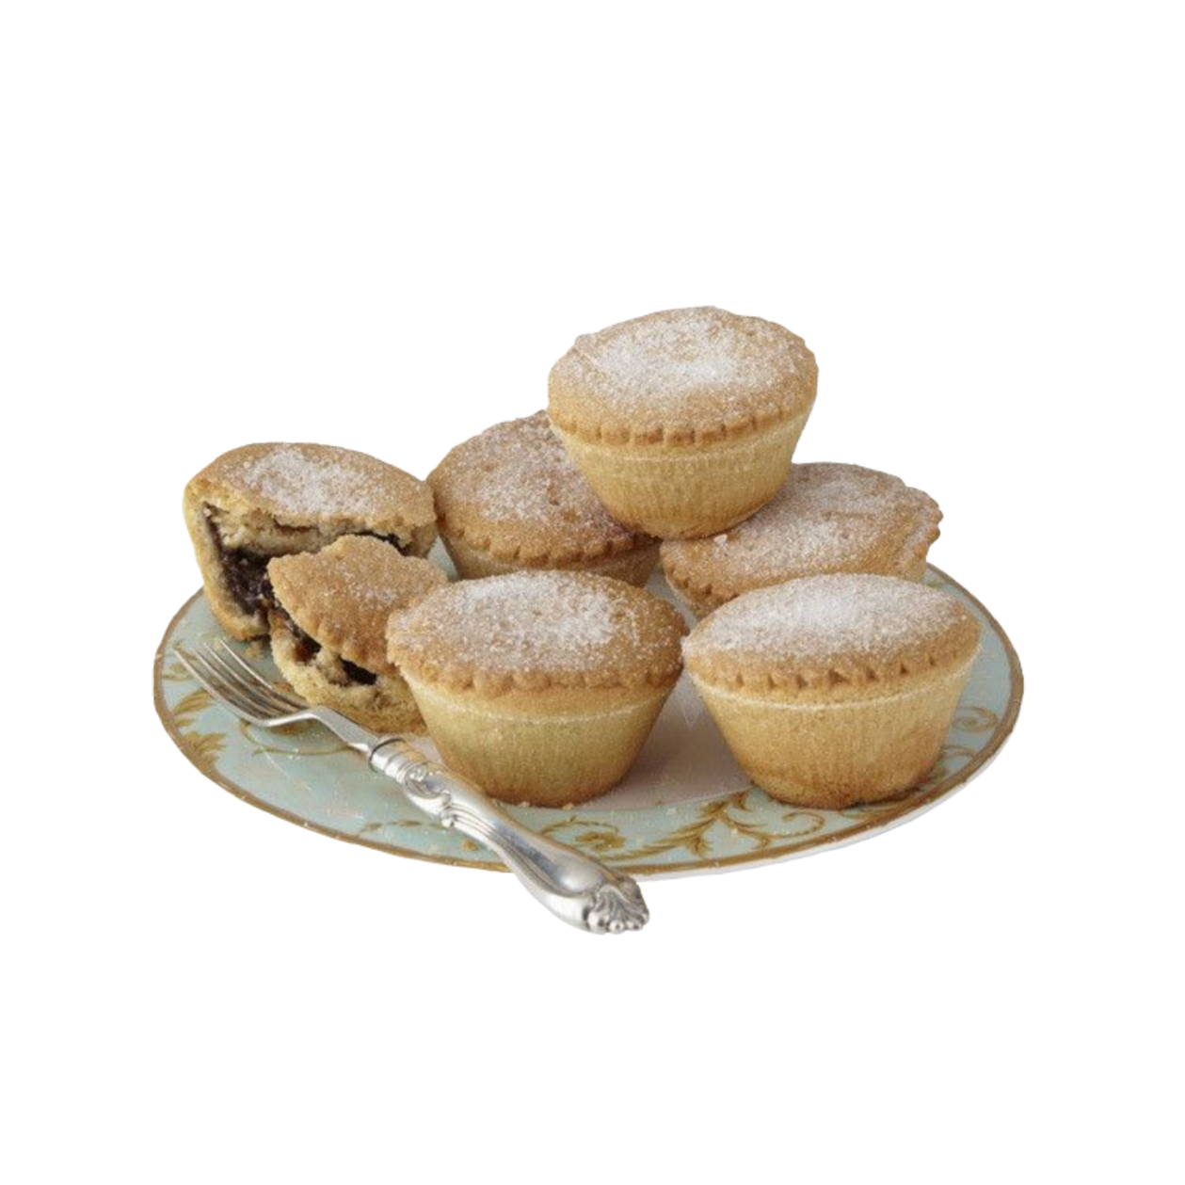
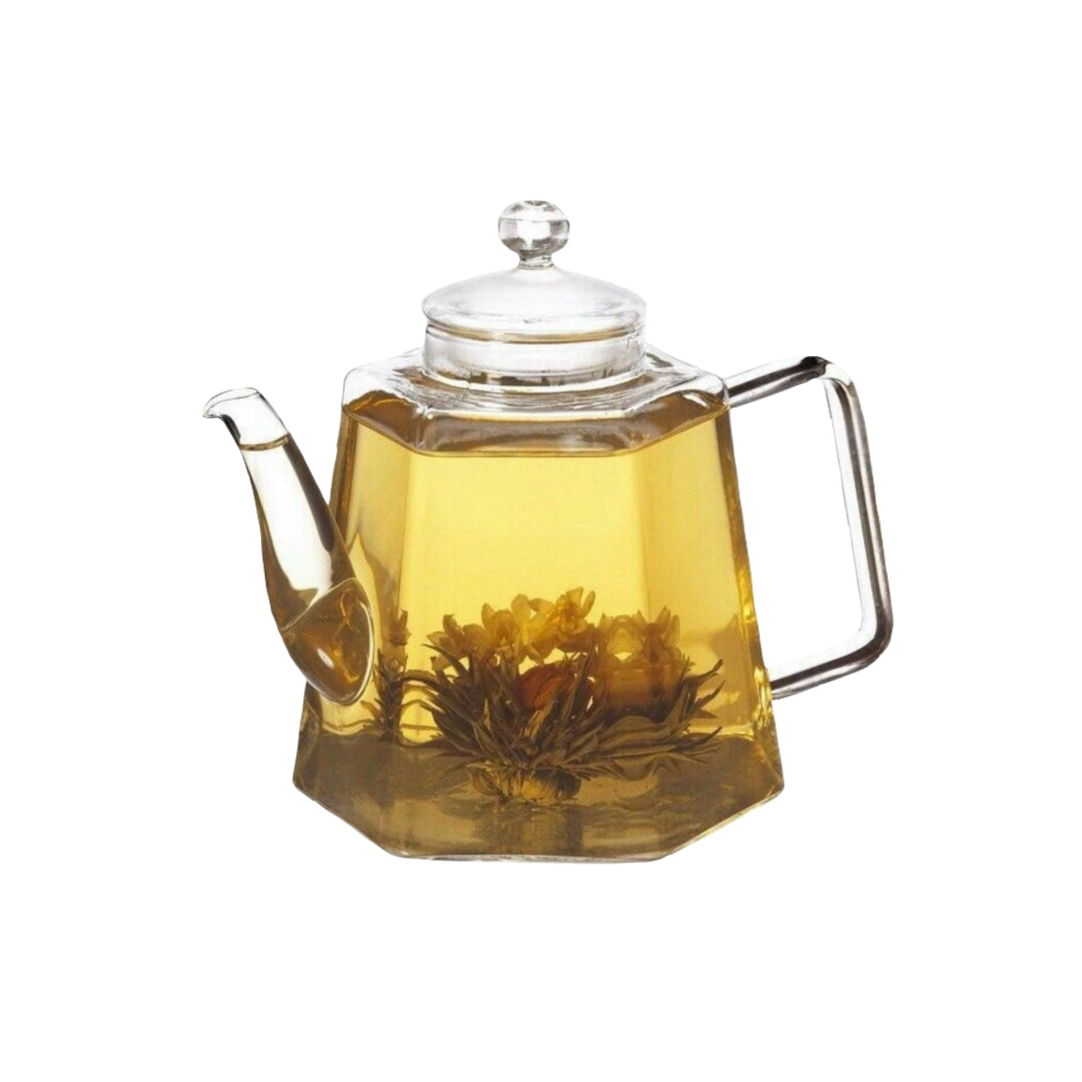
I began to say: We are going to a huge rich but lean table. All members of the family must take part in the preparation of the twelve feasts in honor of the twelve apostles.

Slide 8
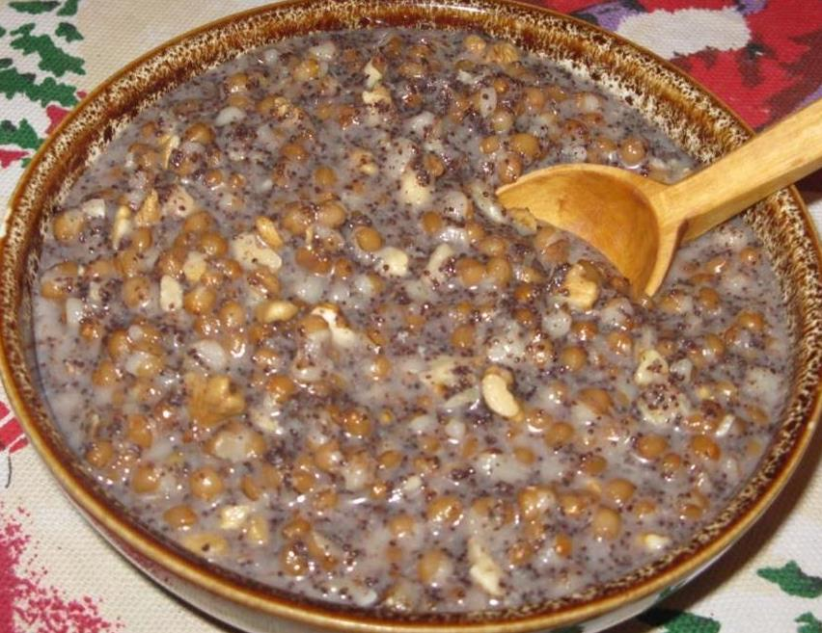
The main Christmas and, of course, favorite dish is kutia. Our kutia is special because it is prepared with the addition of honey and nuts. We always start dinner with a prayer.

Slide 9


Christmas is a holiday of peace, goodness, harmony in the family.

Slide 10
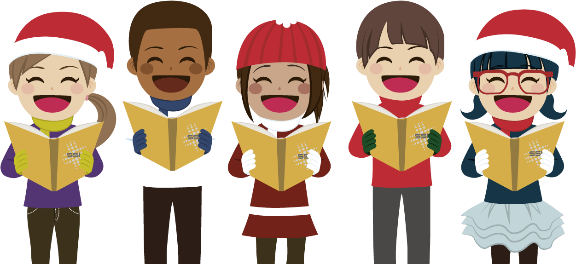
The heart freezes in anticipation of a miracle. After all, Christmas night is rich in magical moments. That's it, Christmas in my big and friendly family. And another Christmas tradition is caroling. They go from house to house to sing carols, without passing anyone. Carols are sung slowly, for a long time. The essence of the carol is in good wishes, festive mood.

Slide 11
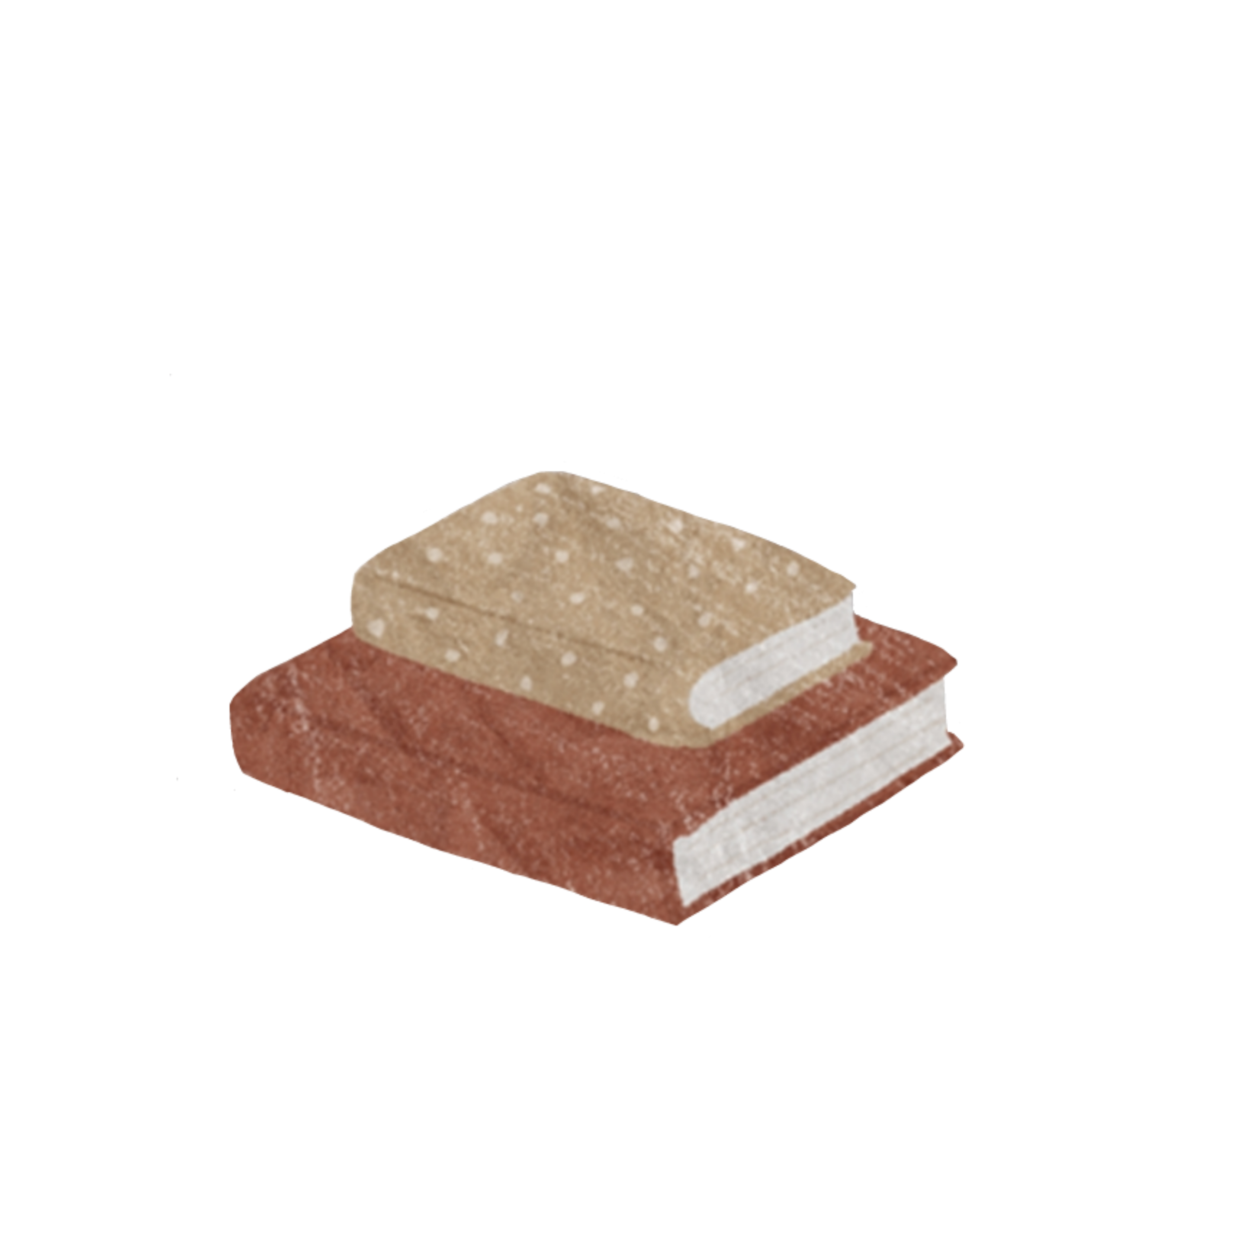

They were happy to hear about how we were celebrating and asked if they could celebrate too. Of course! I answered.

Slide 12
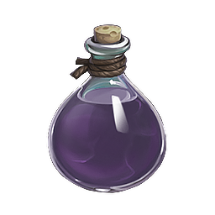
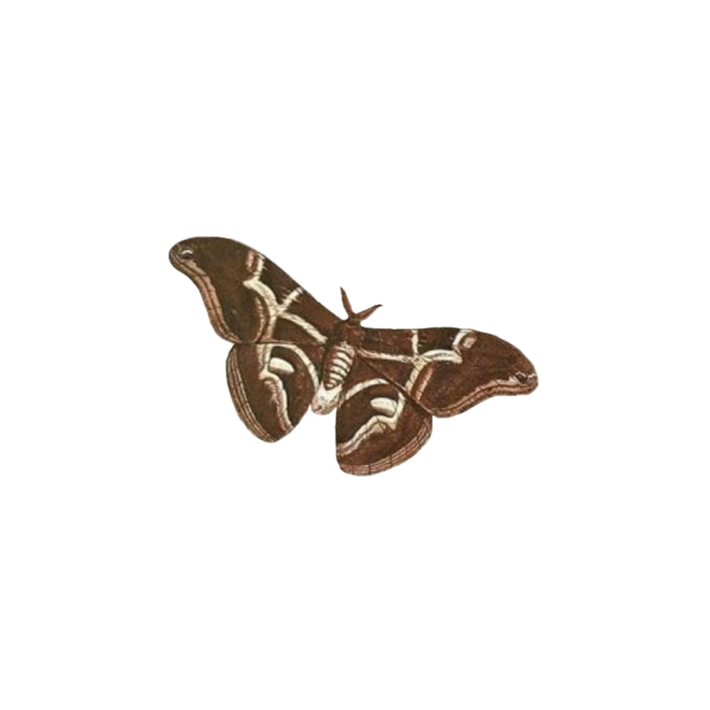

They said I could return home with a magic potion.

Slide 13

One of these creatures took a jar of shiny liquid from his pocket. We said goodbye, I opened the jar and sprayed in the air.

Slide 14

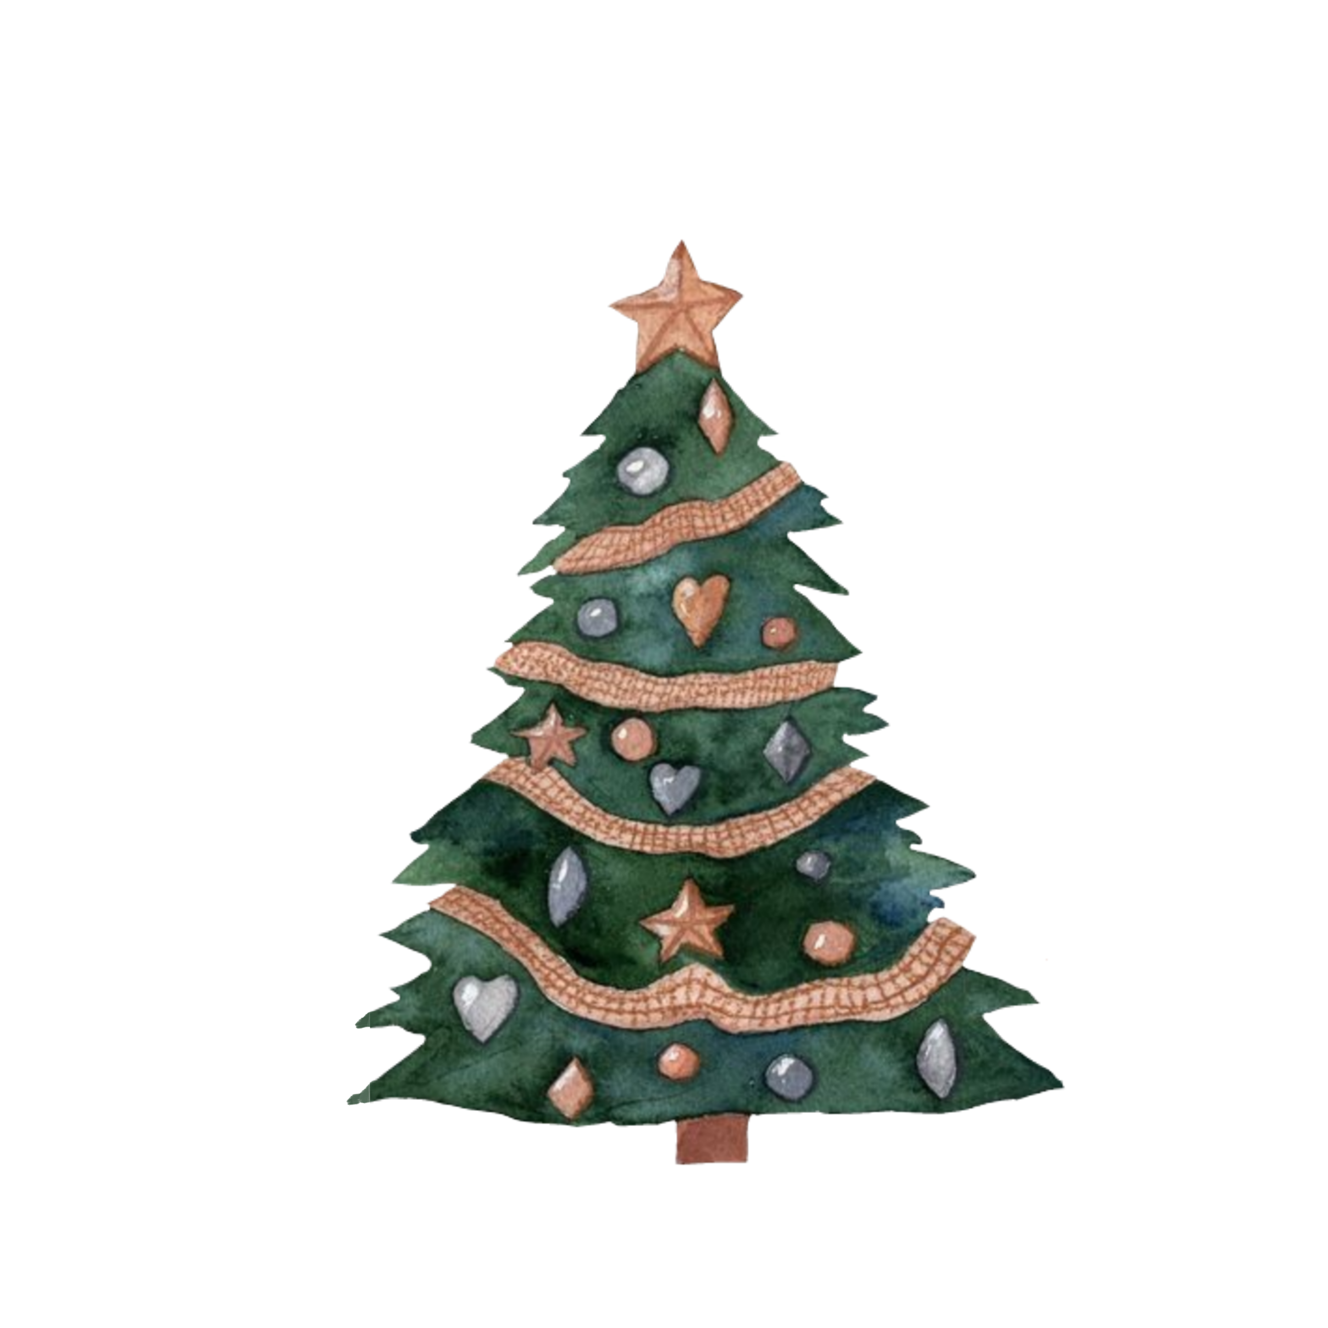
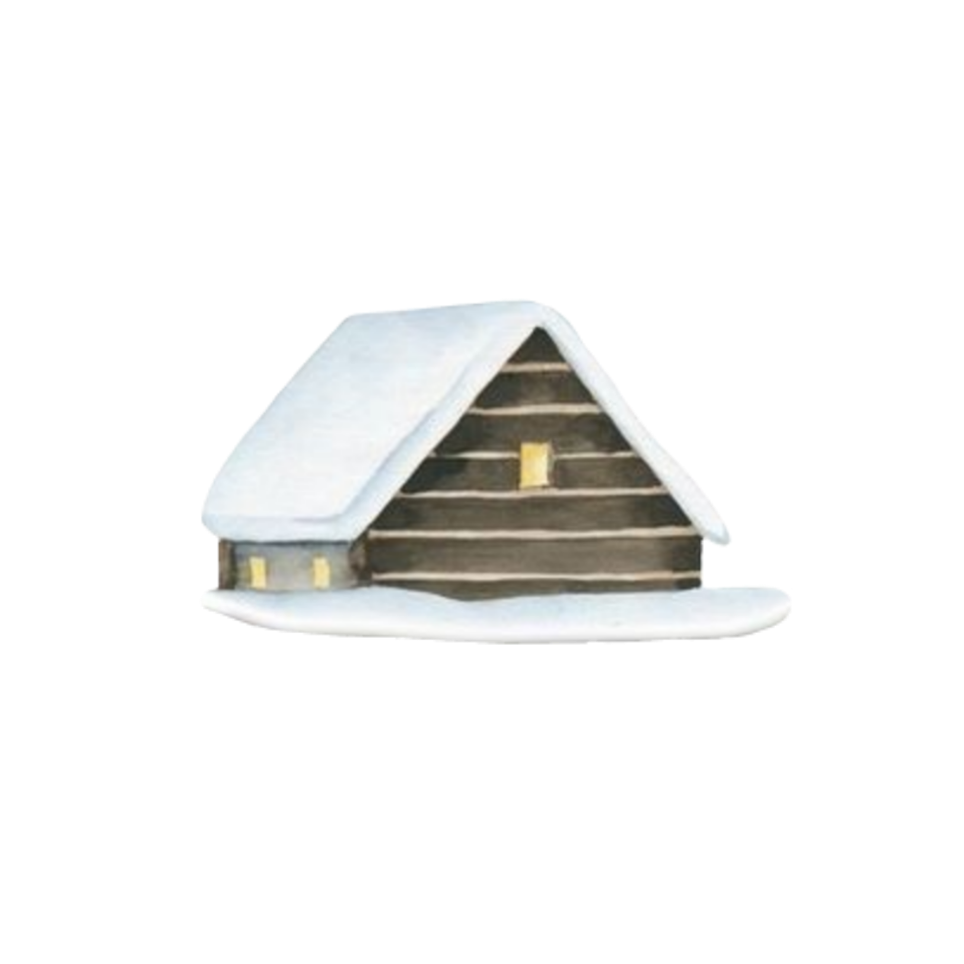
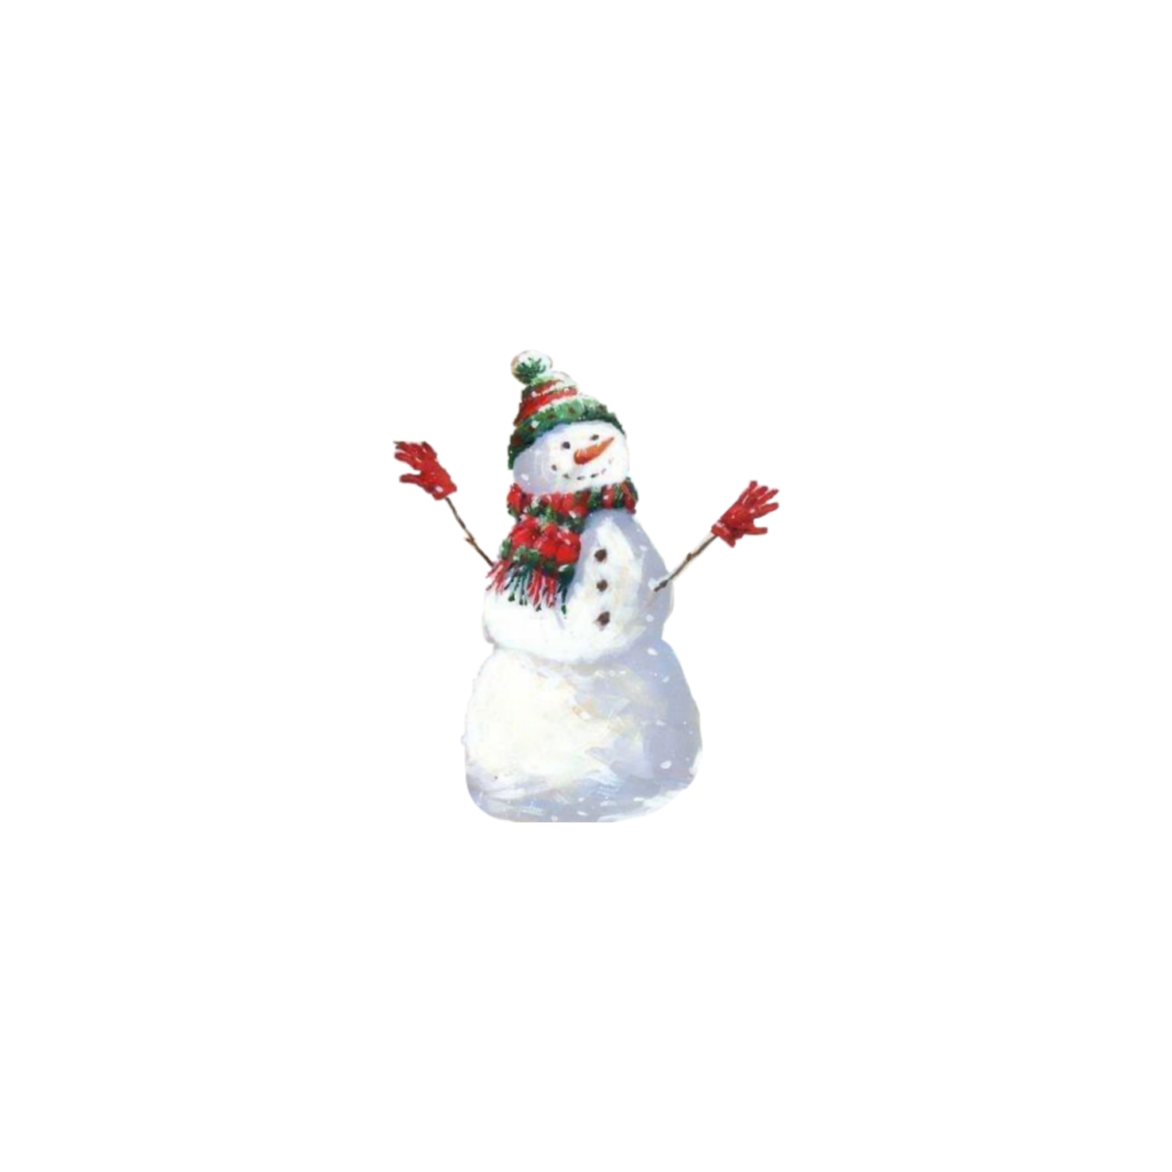

The snow began to whirl, the sparkles began to disappear and here I saw an acquaintance of the area and his house. This is a miracle that happened at Christmas.

