Slide 1


Slide 2
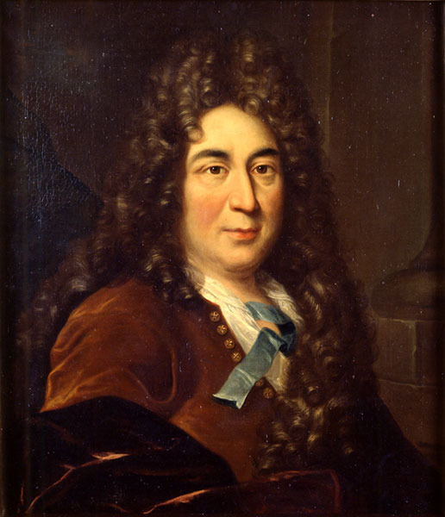
Charles Perrault

Slide 3
About the author
He was born in Paris, France on January 12, 1628.
Charles Perrault was a French author who laid foundations for a new literary genre, the fairy tale, and whose best known tales, offered as if they were pre-existing folk tales, include: Little Red Riding Hood, Sleeping Beauty, Puss in Boots, Cinderella, Bluebeard, Hop o' My Thumb), Diamonds and Toads, Patient Griselda, The Ridiculous Wishes...
Perrault's most famous stories are still in print today and have been made into operas, ballets (e.g., Tchaikovsky's Sleeping Beauty), plays, musicals, and films, both live-action and animation.
The Brothers Grimm retold their own versions of some of Perrault's fairy tales. The author died on May 16, 1703.

Slide 4
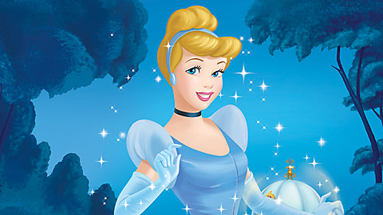
Let’s listen and read:

Slide 5
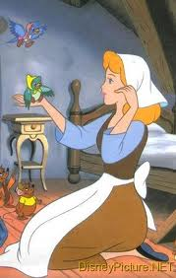
What is she like?
What does she look like?

Slide 6
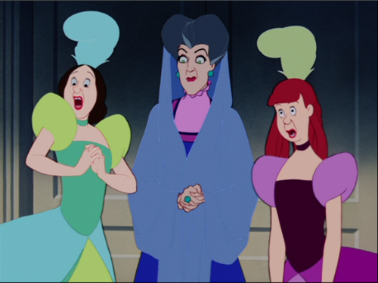
What are they like?
What do they look like?

Slide 7

Do ex.3-p.43

Slide 8
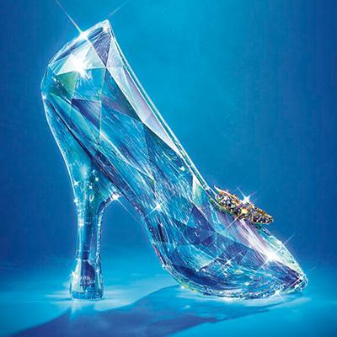
Do ex.4-p.43

Slide 9
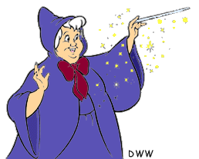
True or false:
1. Cinderella is a beautiful girl.
2. She has got a mean stepmother two beautiful sisters.
3. The ugly sisters don’t go to the ball.
4. The prince is dancing only with Cinderella.
5. Only Cinderella can put on the glass slipper.

Slide 10
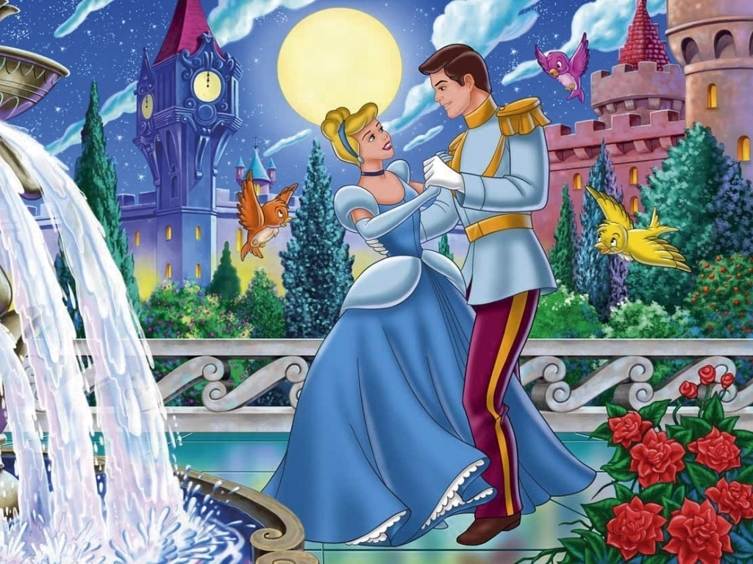
What are your favourite characters in the fairy tale? why?

Slide 11
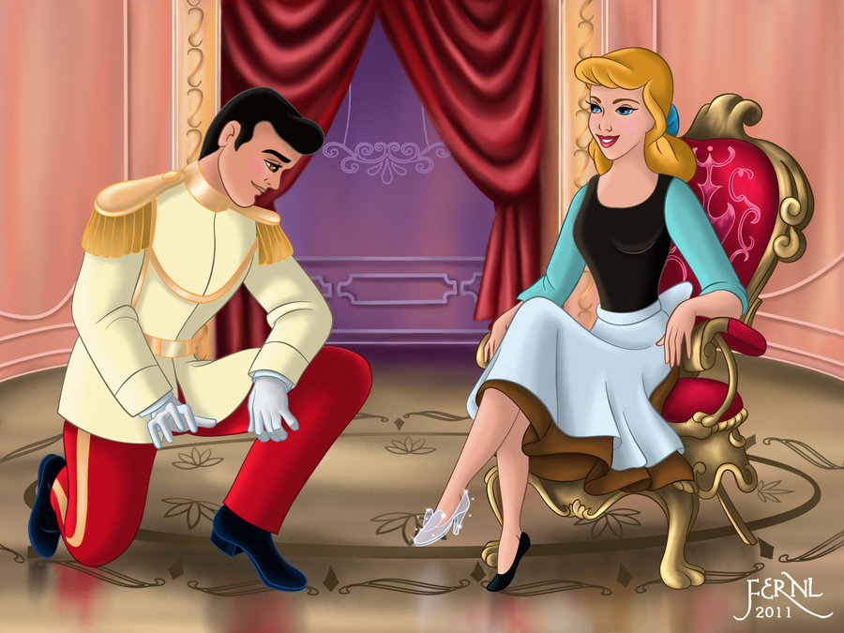
Do ex.5-p.43

Slide 12
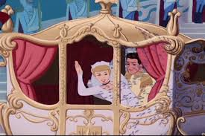
The end

Slide 13
Relaxation

