Slide 1
Once at Christmas time…

Slide 2

Once at Christmas time little boy was writing a letter to Santa Claus. His name is Tommy. He’s asking Santa about different toys, sweets and other things that every child want for Christmas. When he finished, he put this letter beside window. At night Santa’s assistant elf Robin got a letter from Tommy’s house and deliver it to North Pole

Slide 3
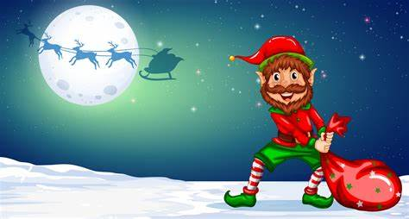
. Everything is going well, he’s getting other letters from other houses. Suddenly, someone hit him and he lost all letters. It was Santa’s biggest enemy, his name is Korvin. Many years ago he was an elf as well, but when he tried to steel all presents from Santa’s factory Santa Claus kicked him out from North Pole and he hates Christmas since it happened. He want destroy all happiness for kids and whole world. Now he got all letters and Santa won’t give presents for children.

Slide 4

At this time old Santa Claus is waiting for Robin and letters in his cozy house next to the fire place, he’s really looking forward for Christmas night and trip around whole planet. But Robin is not back yet. Santa started to worry about him. He decided to go find him and it was right decision. Santa found him lying down on the snow. Robin told Santa about everything what happened and made him really angry.

Slide 5

Santa Claus didn’t know what to do, but after few hours of thinking he found an answer. He decided to produce all kinds of presents at his factory and give a one specimen of each type of presents. For example give one candy cane, one toy, one cookie to each kid. This is great decision and Christmas is being saved.

