Slide 1

Nellie Bly

Slide 2
Do you think that a newspaper reporter is an interesting job?
Would you like to be a reporter?
If you were a reporter what would you like to write about?

Slide 3
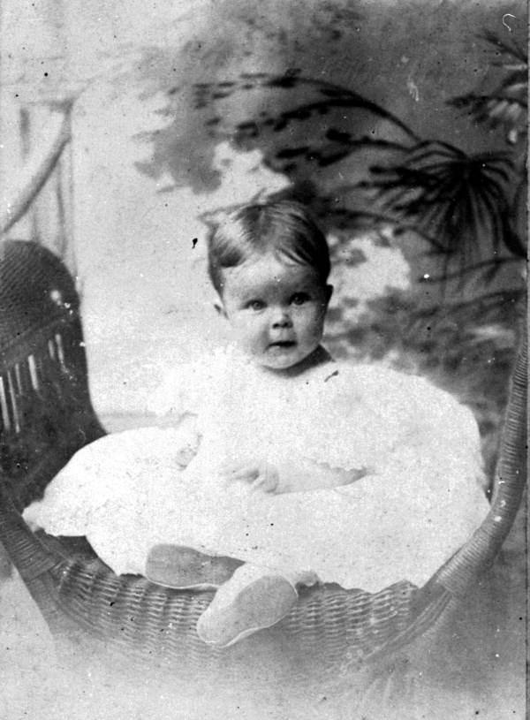
Who wrote the story?
What is the story about?
Who is the main character?

Slide 4
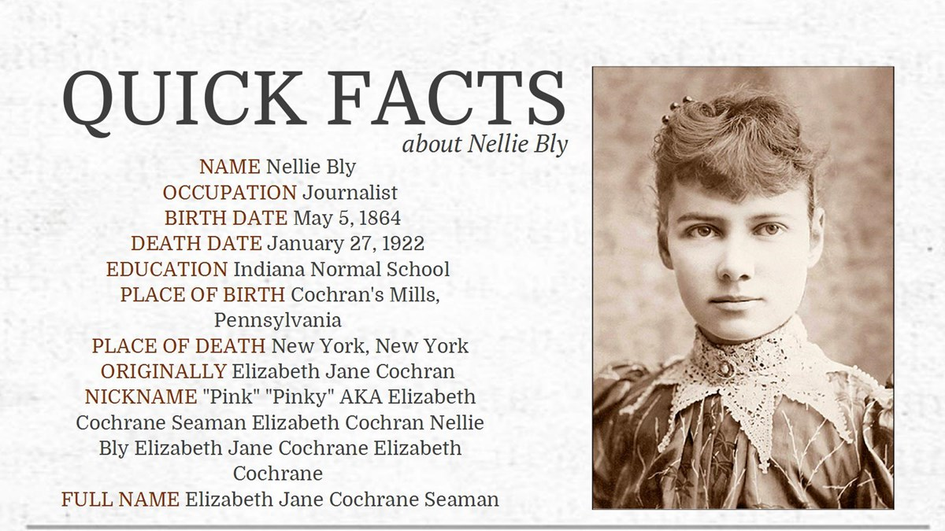

Slide 5
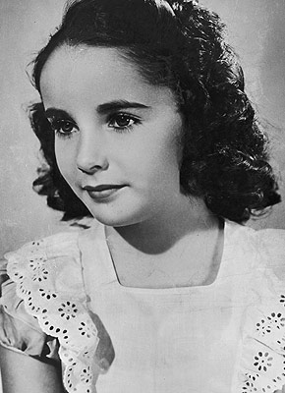
Find English equivalents in the text
Піклуватись
Шукати
Редактор
Розум
Заробляти на прожиття
Репортер
пароплав

Slide 6
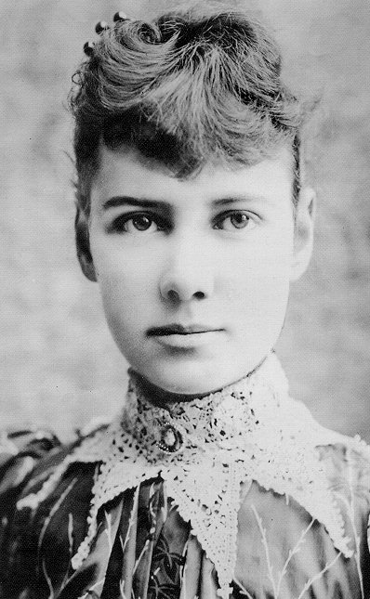
Listen to the text then read and translate it

Slide 7
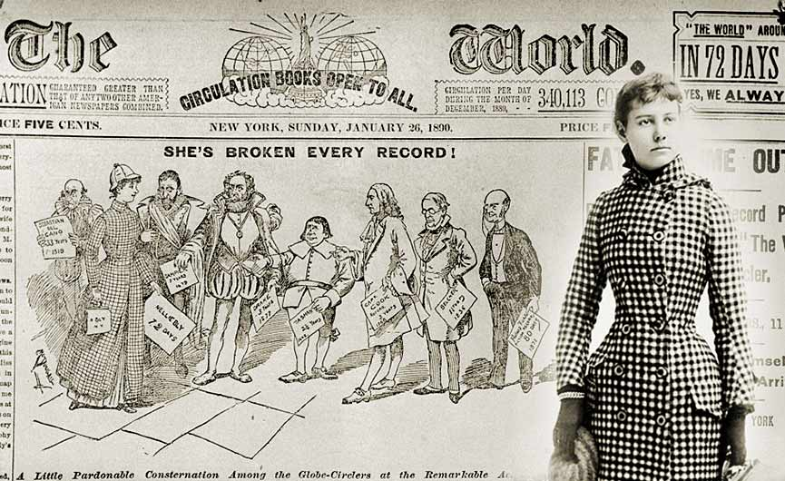
Put the destinations of the trip in the right order
China
The Mediterranean Sea
Italy
San Francisco
Japan
France
The Pacific Ocean
England
New Jersey
The Red Sea
The Suez Canal
The Indian Ocean

Slide 8
Rearrange the sentences according to the text
Had an interview with the editor
Was given money for the trip
Sent her letter to a newspaper
Visited a lot of countries
Was greeted by many people on her way to New Jersey
Started to write about poor people
Returned home
Began to work as a reporter in New York

Slide 9
