Slide 1
Once at Christmas
Vitalina Madyniak

Slide 2
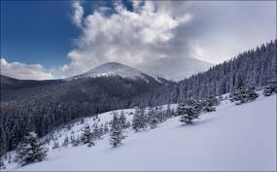
Once at Christmas I and my friends decided to go to the highest peak in Ukraine , Mount Hoverla. Because we wanted something extreame

Slide 3
But we didn’t know how to behave and what to take with us , so I enrolled in special courses. We were given a special person who started training.

Slide 4

First of all we needed to do physical education : run, go to the gym , take a contrast shower.

Slide 5
She also said that physical training is not the main thing . The main role is played by your desire to climb to the top .We listened to all her advice.

Slide 6

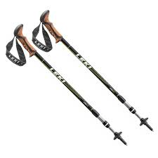
Then we asked what to put in the backpack , she replied:a bottle of water,and something high-calore to regain strength,a first aid kit,and another important item of equipment are trekking poles,if you want you can rent them on the spot.

Slide 7

We listened carefully to Iryna advice and went on a hike for Christmas . We were already halfway up the mountain , and nothing foreshadowed trouble , but suddenly began heavy snowfall , very shallow and it was impossible to continue the hike , so my friends and I decided to wait for the snowfall.

Slide 8
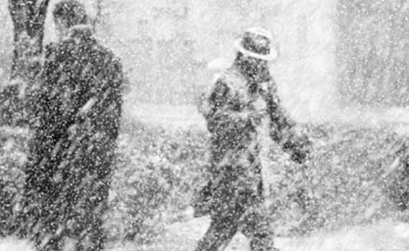
When everyone was together , we saw that Olesya , our friend , was missing among us and no one knew where she was . Panic broke out among us,and despite the fact that it was very small , we went to look for Olesya.

Slide 9
The snowfall gradually subsided , but it was quite cold , and Olesya was not there , but we did not give up und continued our search. And Suddenly we heard the voice of our friend shouting :»Olesya has been found , everyone is here ». We quickly ran and saw Olesya lying on the ground , because her leg hurt a lot.

Slide 10
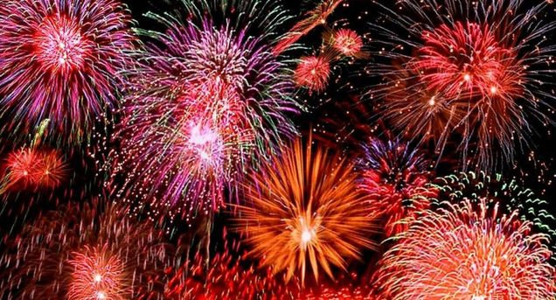
We took her in our arms and wanted to return home , but Olesya was adamantly against us returning . She said didn’t want to play sports this Christmas so we went up the mountain helping Olesya . It was beautiful landscape . We have never seen. We took very beautiful photos, and even launched a fireworks display , without exaggeration , it was our best Christmas.

