Slide 1
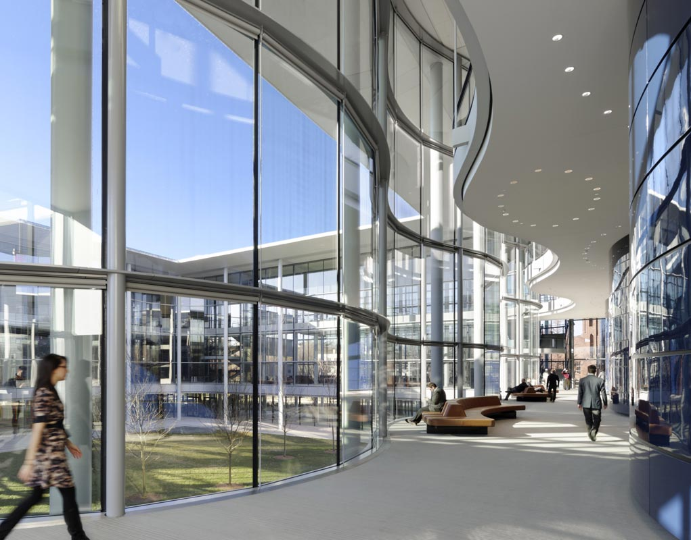
School of my dream
Prepared by Yanina Madyniak

Slide 2
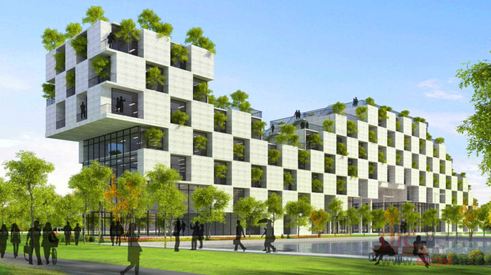
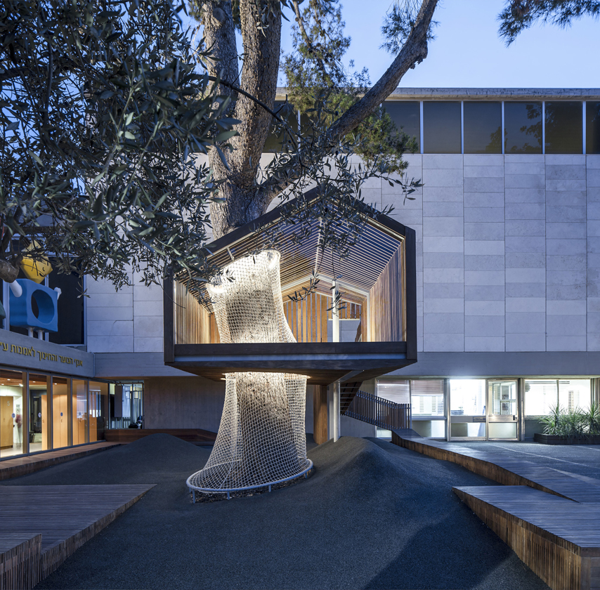
School of my dream must be built in high – tech style. Basic colors would be white with wood and bright green elements. Nature motives must be included too. I think that a big tree in the centre of the school it’s really a cool idea. Besides little animals like squirrels or butterflies, that would live there can cheer up somebody after a bad lesson.

Slide 3
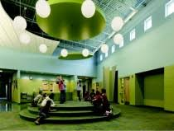
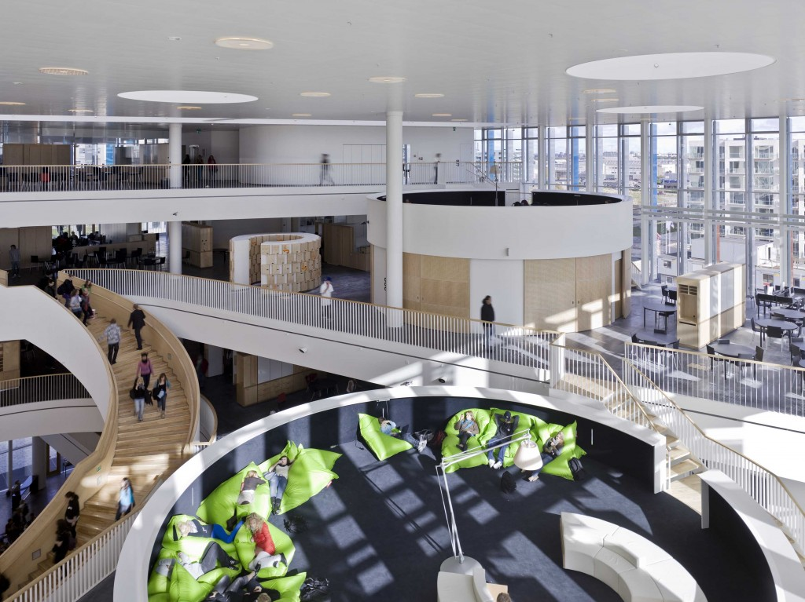
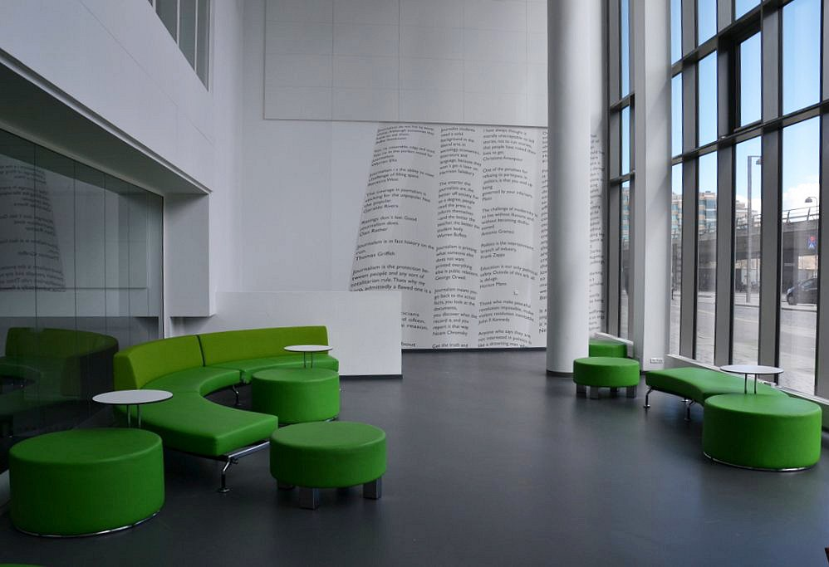
There must be comfortable chairs and tables, where pupils can have a rest or a talk with each other and free WIFI-zone

Slide 4
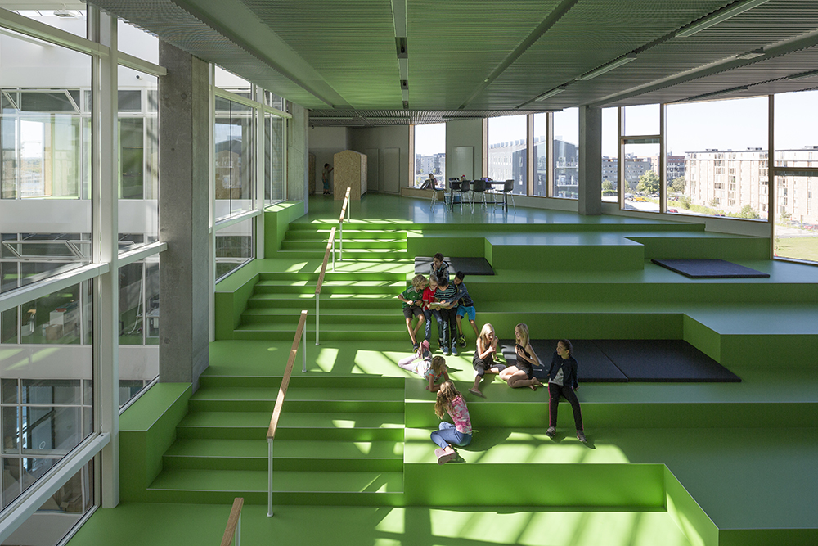
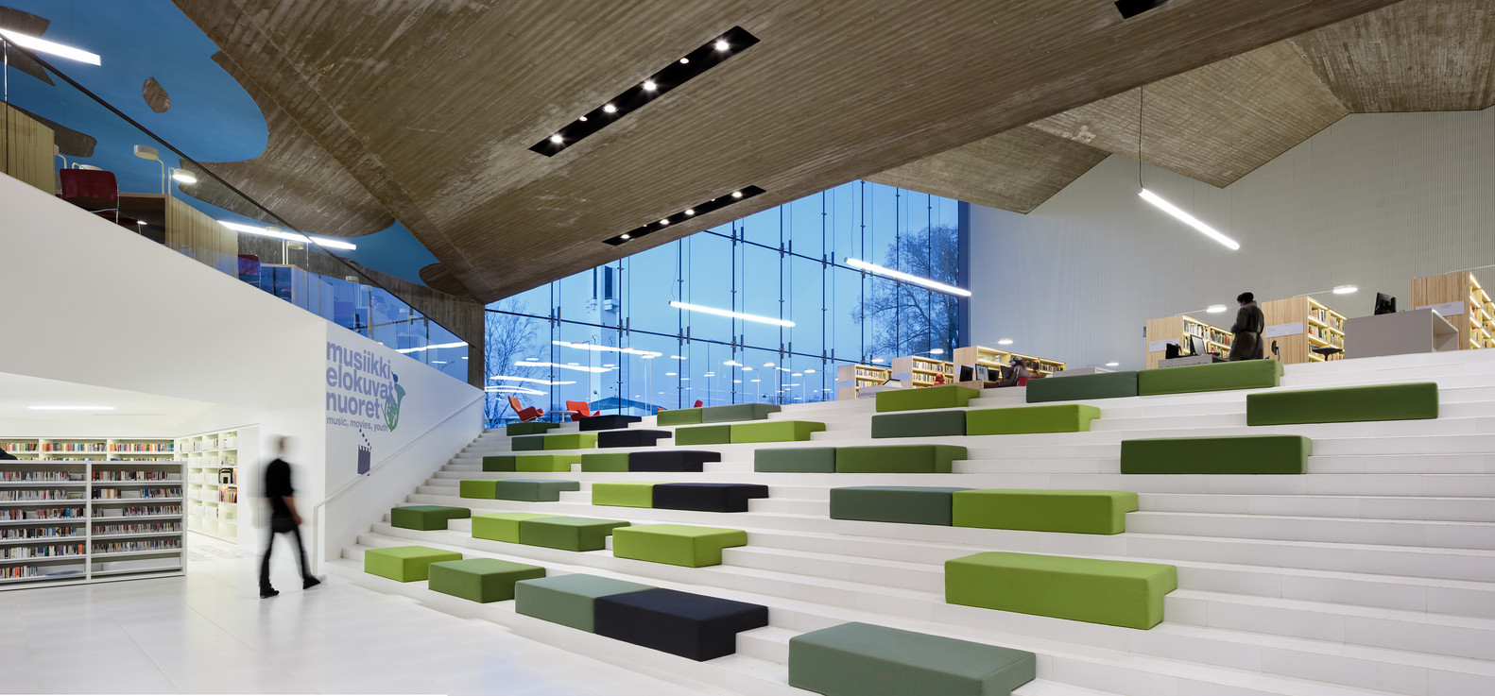
Building for important events or actions would be big and interesting

Slide 5
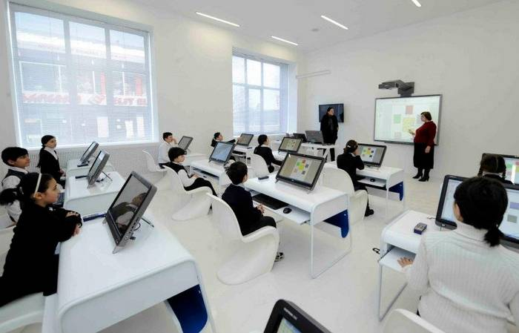
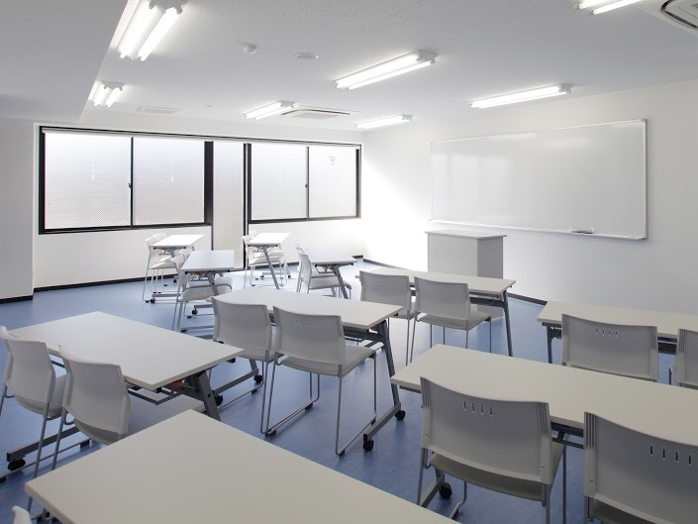
Classes must be well-equipped: a modern white board, new comfortable desks, big light windows. For older pupils would be included computers or tablets.

Slide 6
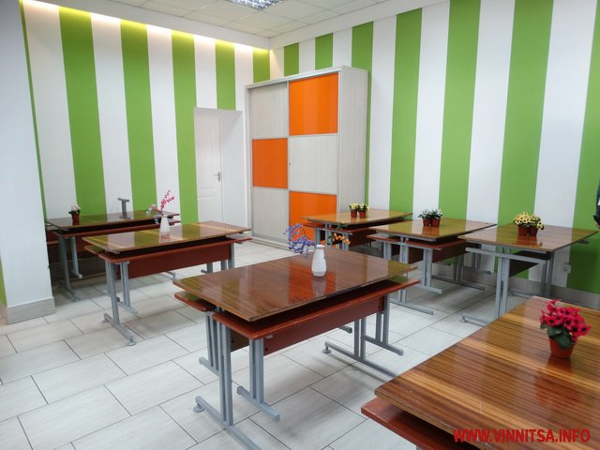
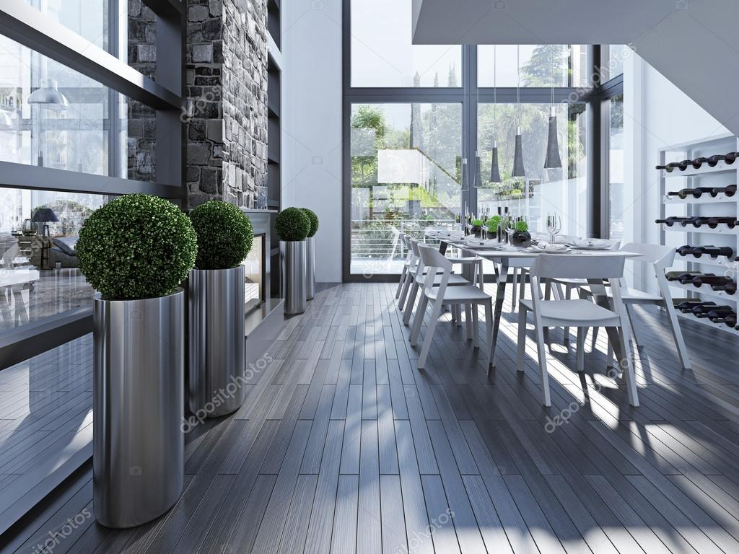
School canteen is a place where you take energy for study, so it’s must look well.

Slide 7
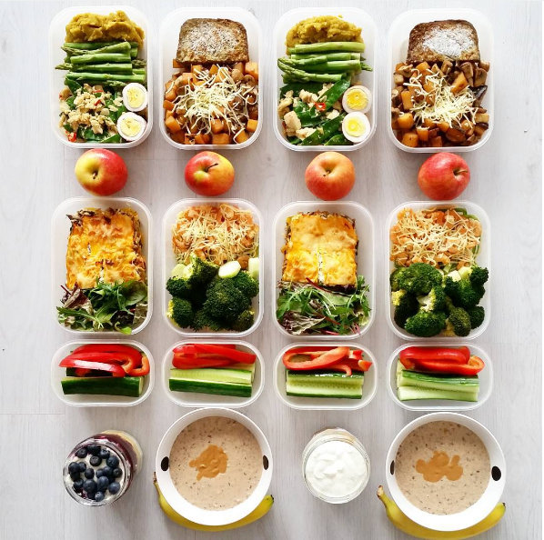
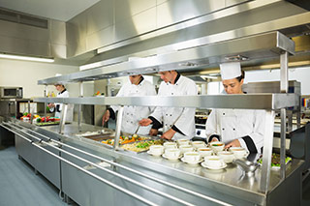
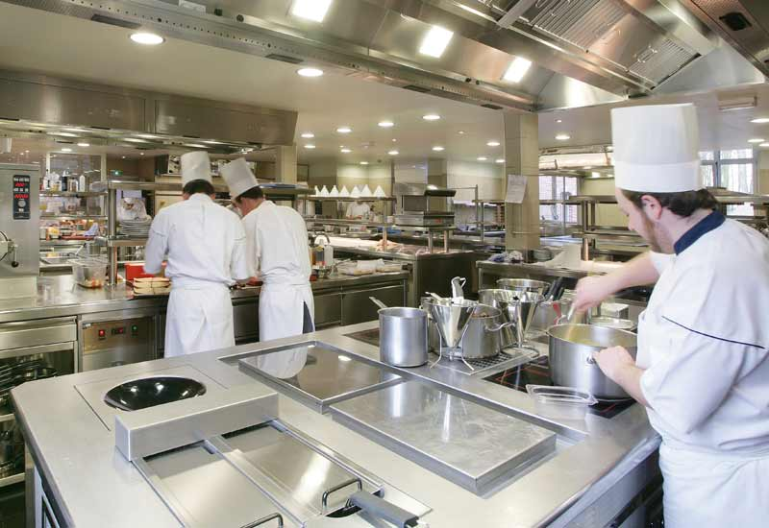
Dishes must be healthy, delicious, made in cleanness and order.

Slide 8
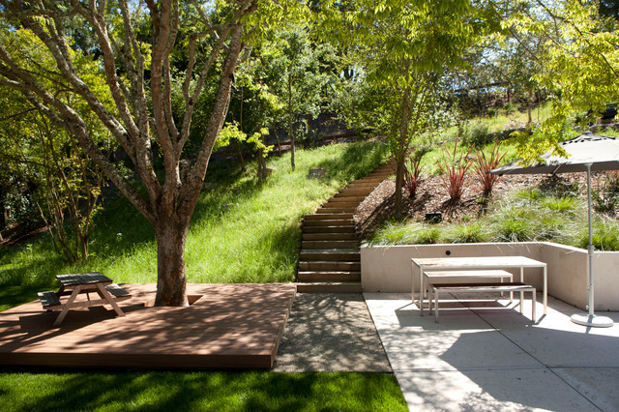
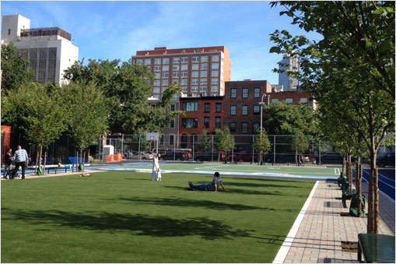
I want to see a big school-yard, where pupils can play and walk at 20 -minutes breaks

Slide 9


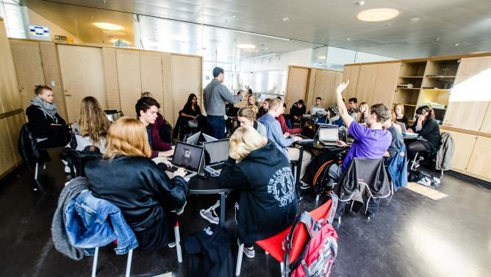
Teachers are important part of school. They must be understanding, fair, professional and smiling.

Slide 10
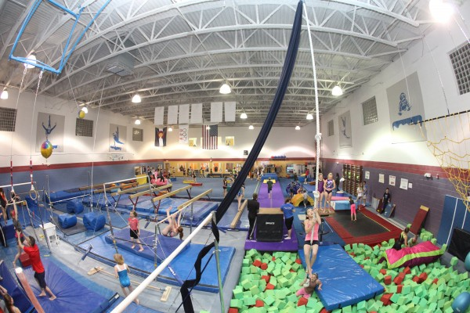
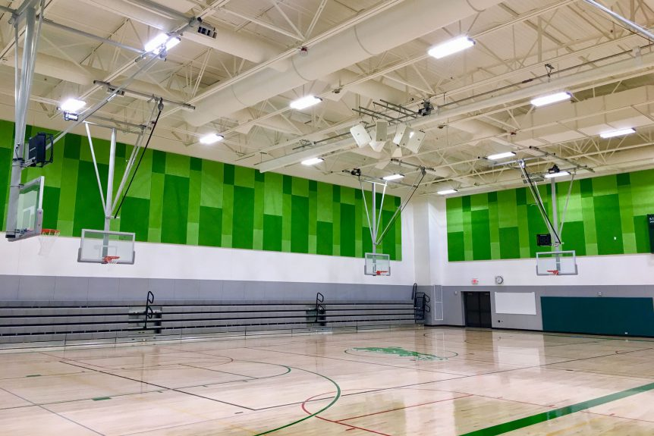
School gym how I imagine it:

Slide 11
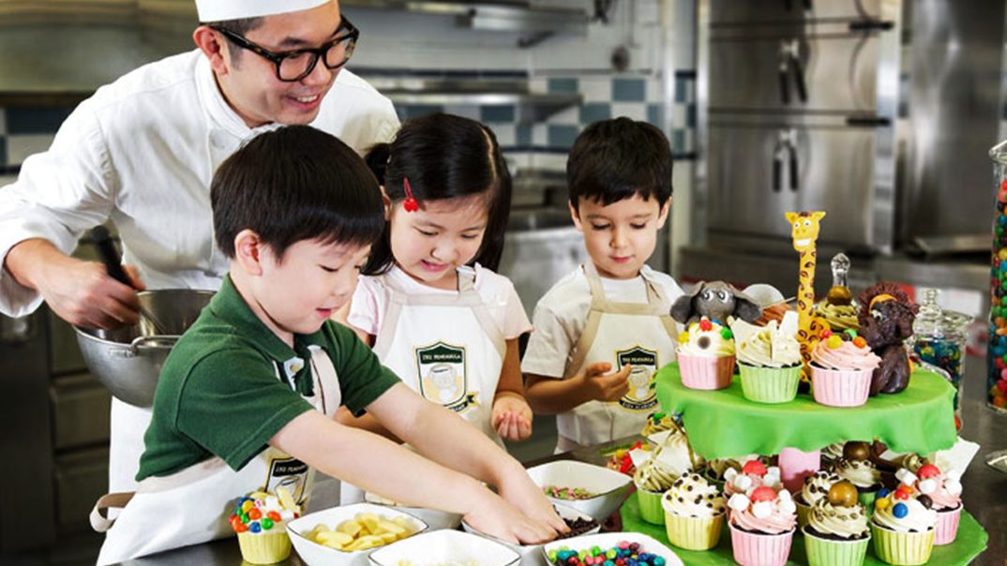
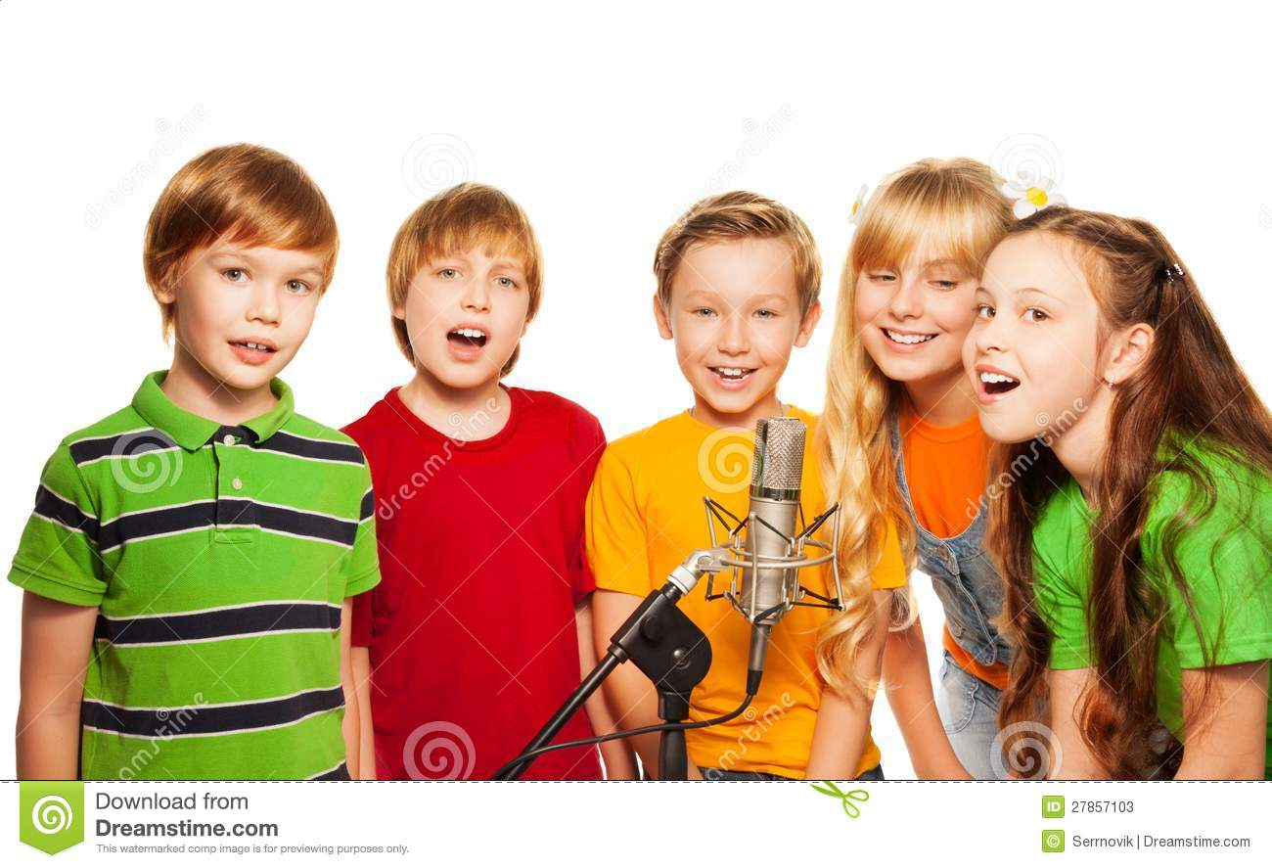
I think that different groups and clubs are very interesting and curious occupations. And school of my dream must have: drama groups, music club, art and design unification, culinary courses.

Slide 12
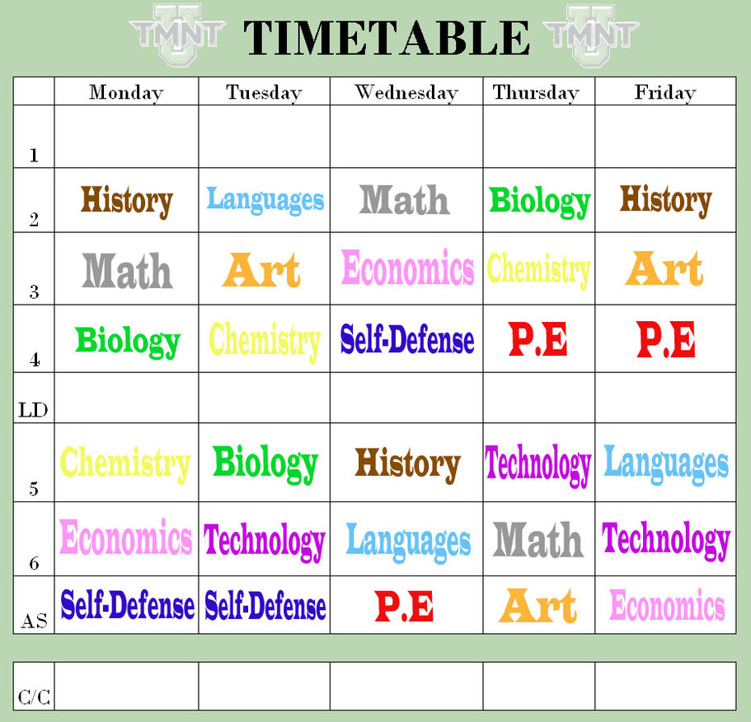

Slide 13


Slide 14
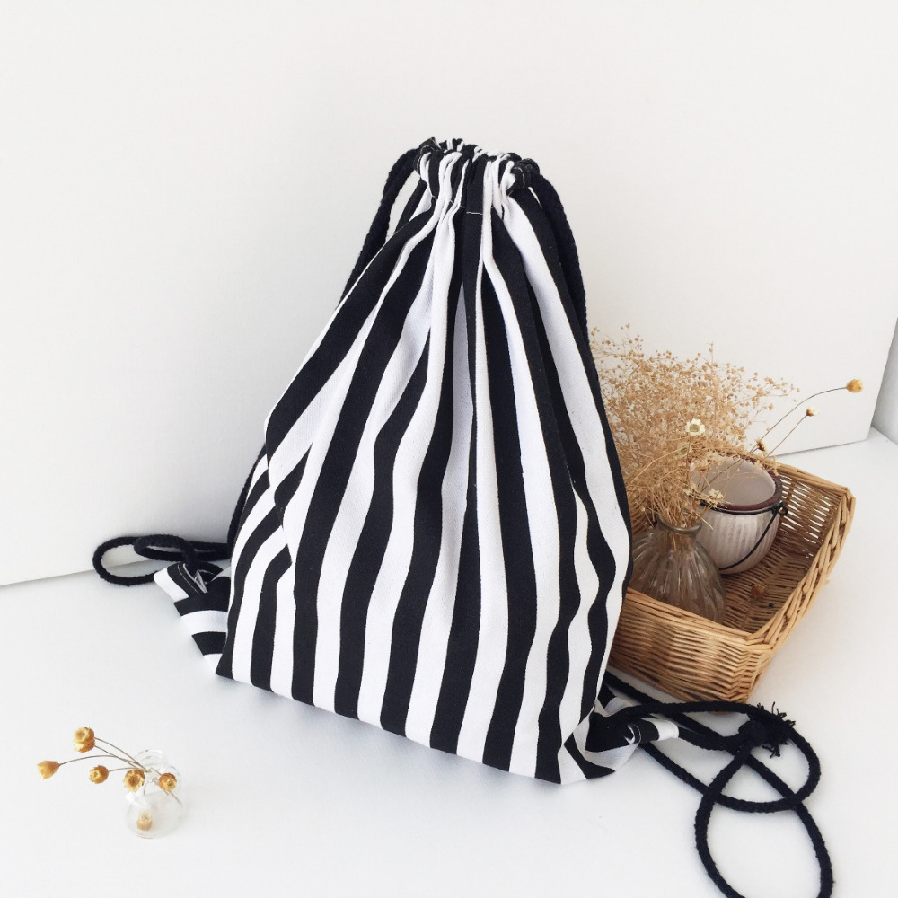
Thank you for attention

