Slide 1

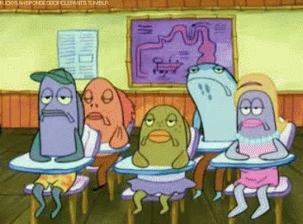

School of my dream
Prepared by Yulia Tatsynets

Slide 2

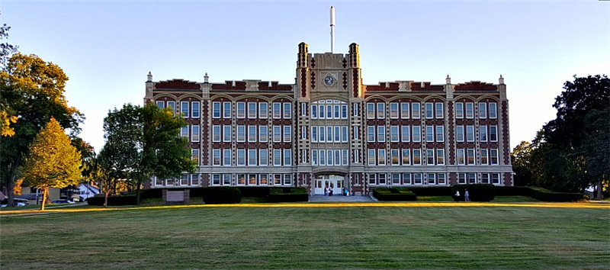
School of my dream must be light and big – in eco style. Basic colours can be white with different brown details .

Slide 3

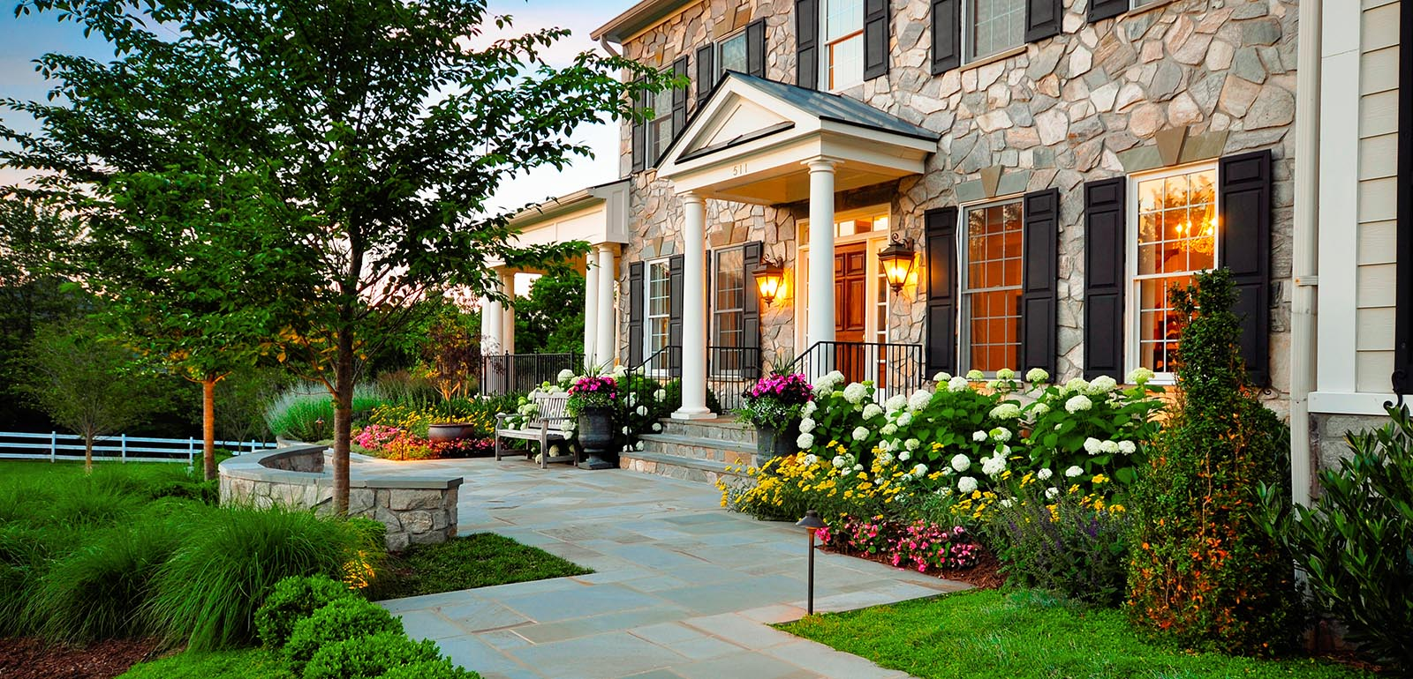
School yard I would like to see big with plants, flowers and trees. Also there must be benches.

Slide 4

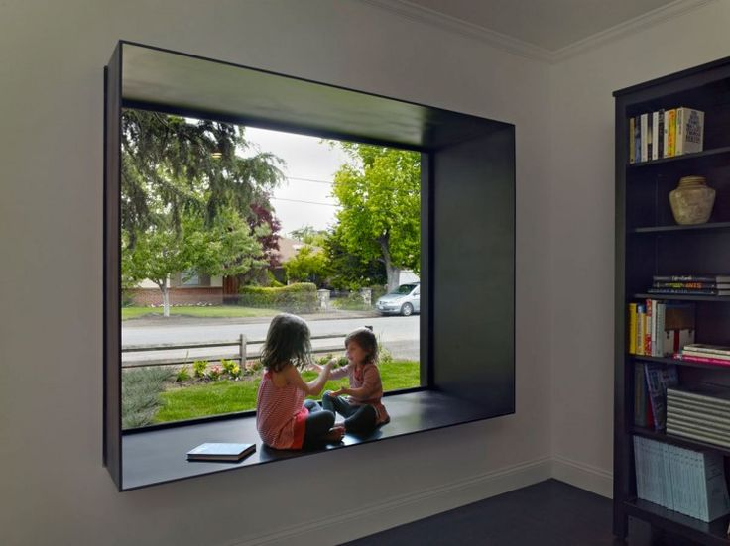
Windows in the school must be plastic, white with big window-sills for children to sit down during breaks

Slide 5
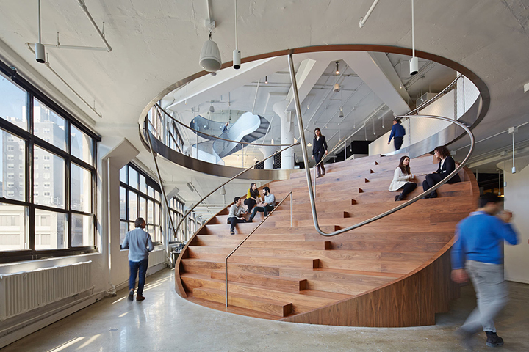
School must have two floors

Slide 6
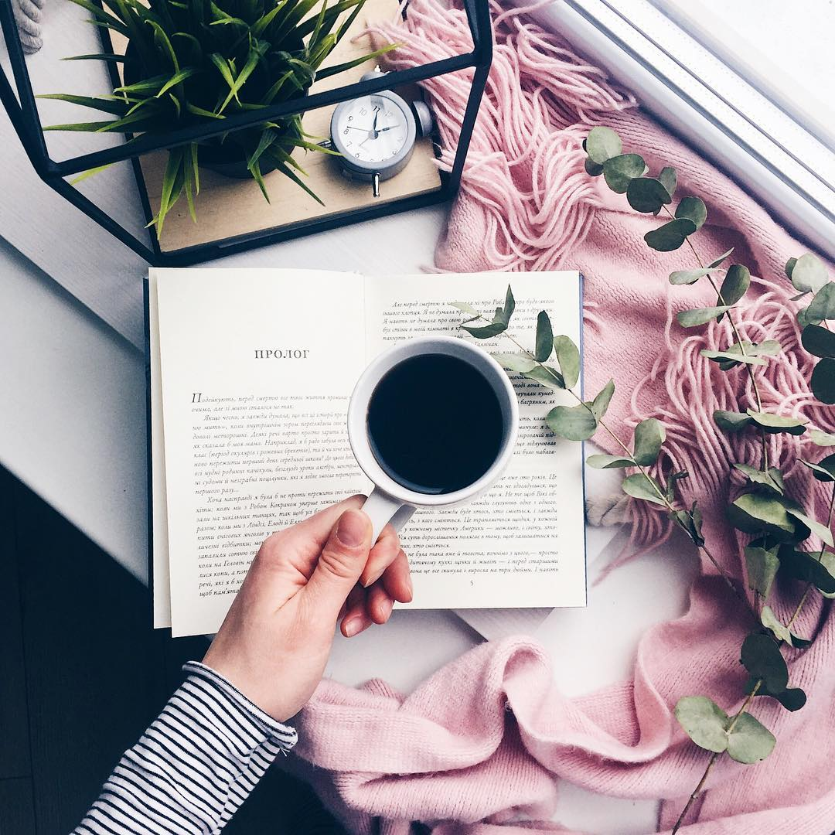

Every classroom must be well- equipped

Slide 7
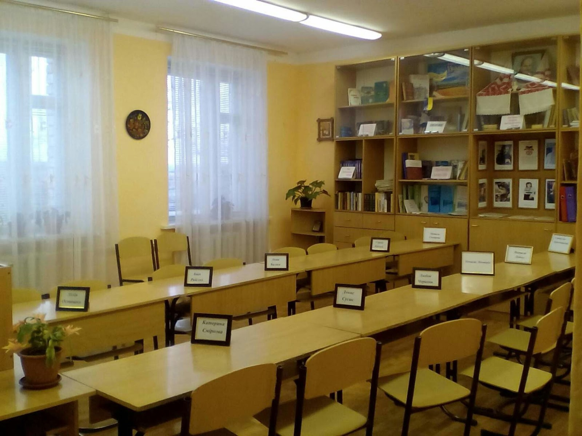
Ukrainian classroom

Slide 8
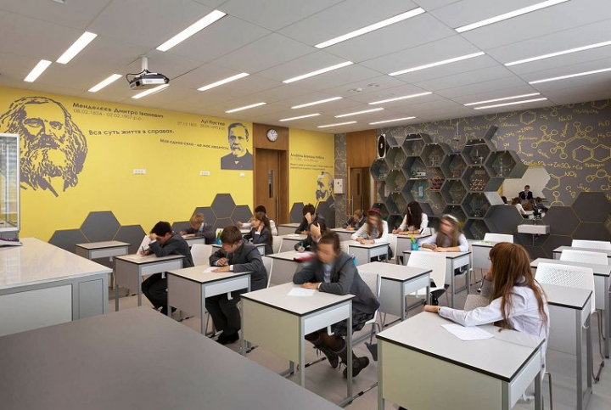
Science classroom

Slide 9
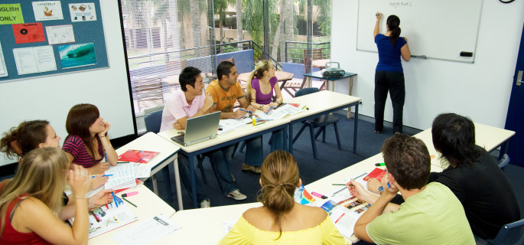
English classroom

Slide 10
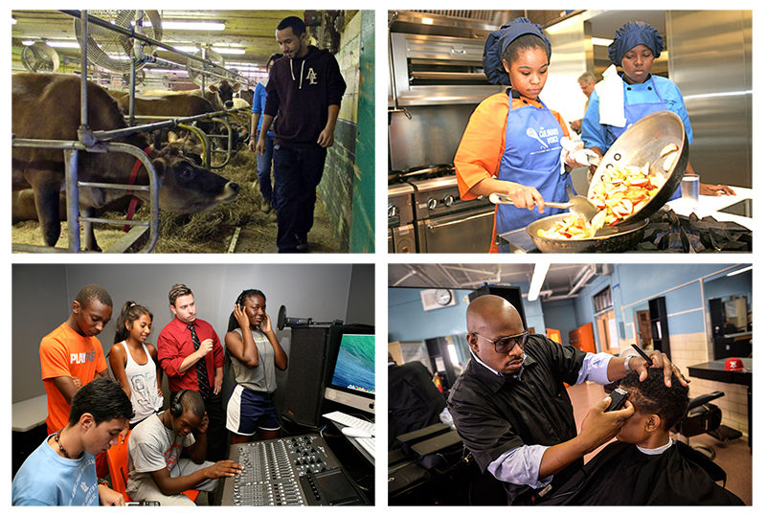
Technical education classrooms

Slide 11
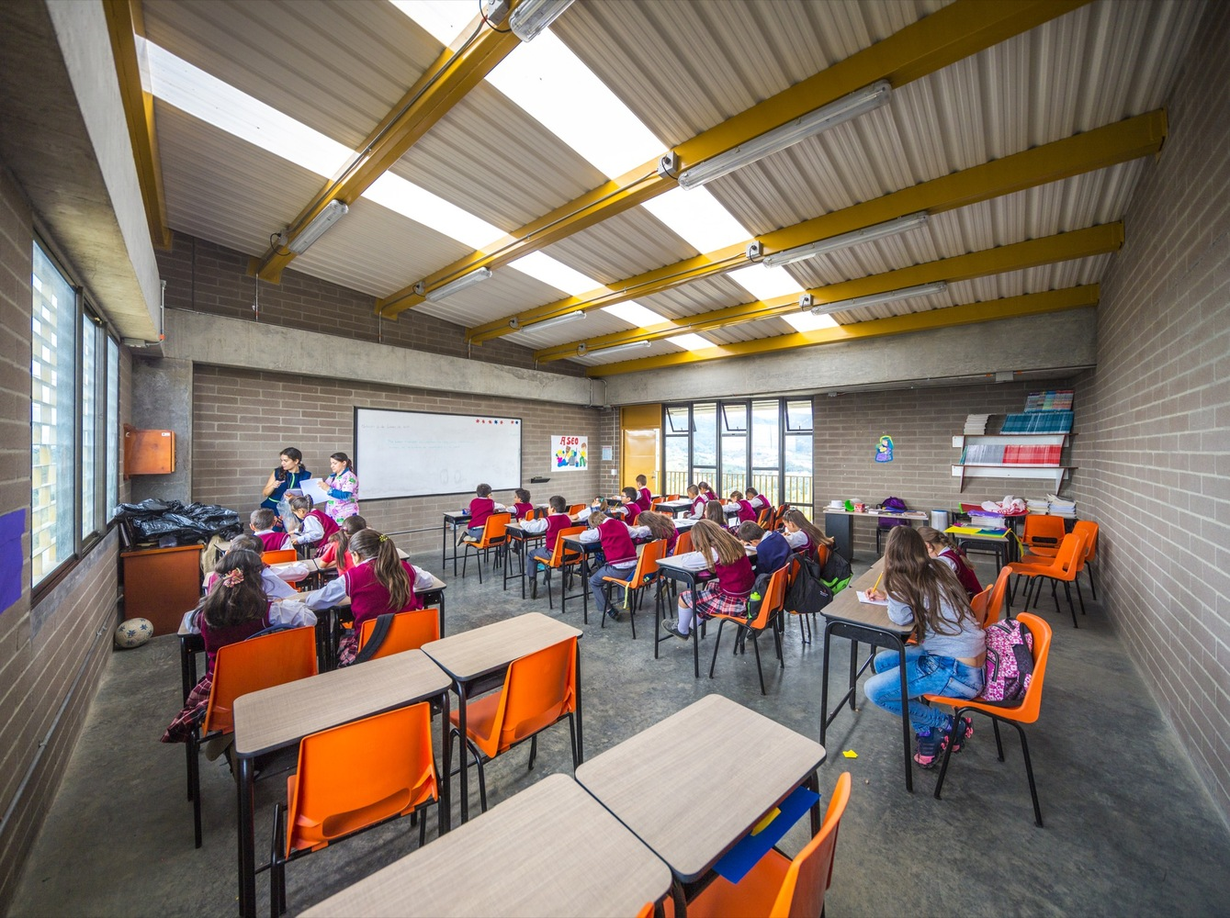
Other classrooms can look like this way

Slide 12
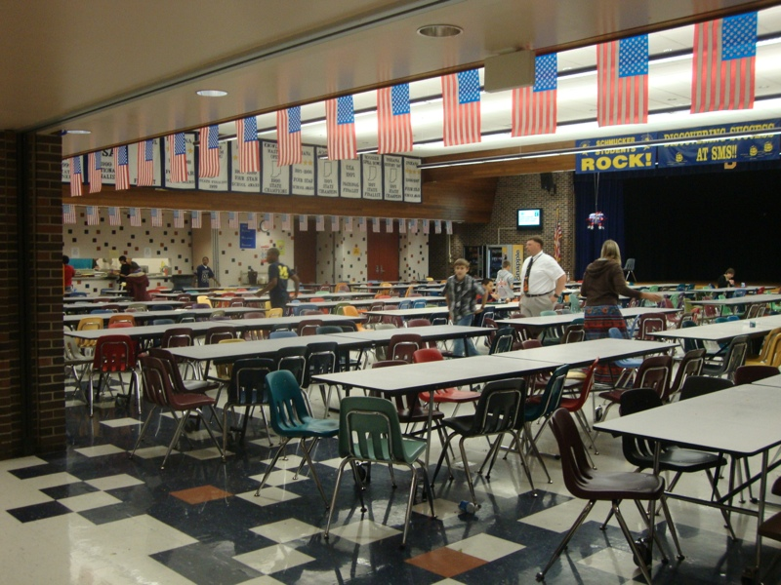
We should have lunch at twelve o'clock. All children will eat lunch in the canteen.

Slide 13
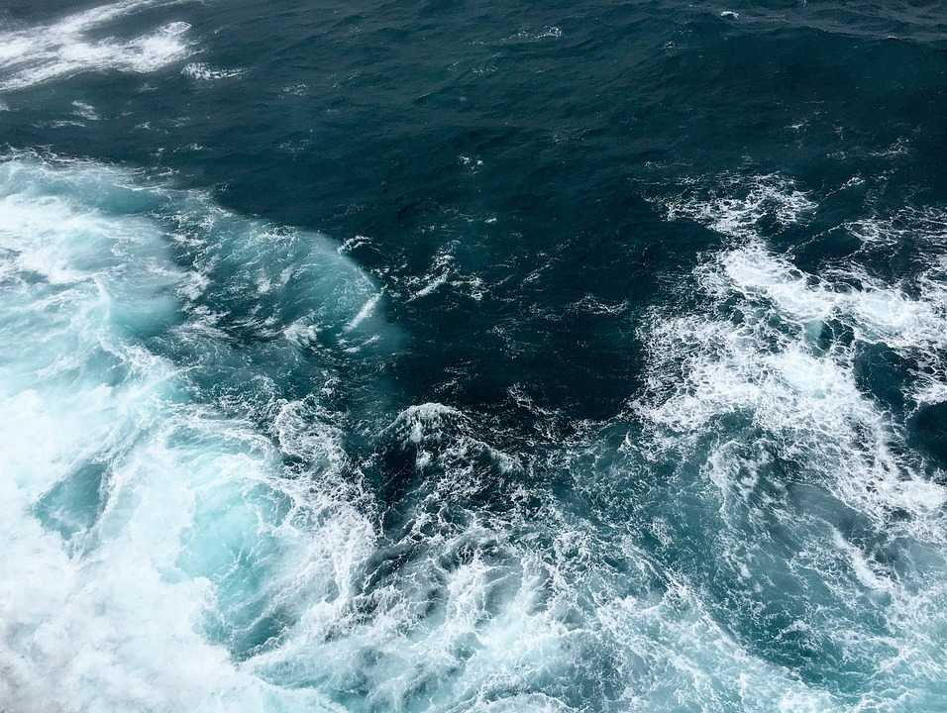

We shall go to school from Monday to Friday. School will start at 9 o'clock. Break must be always after every lessons. There will be a 20 minute break at half past 10.

Slide 14

I think, that uniform must be comfortable but beautiful. It can be a white blouse, a red skirt of two colours long white socks and a red jacket. Every girl can have unplaited hair but most of them go with a ponytail .

Slide 15
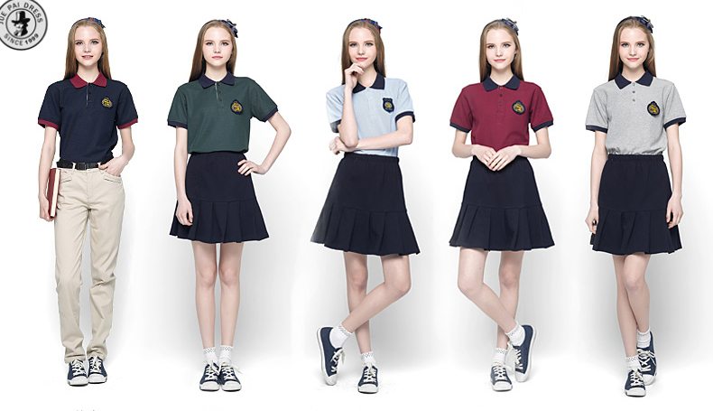
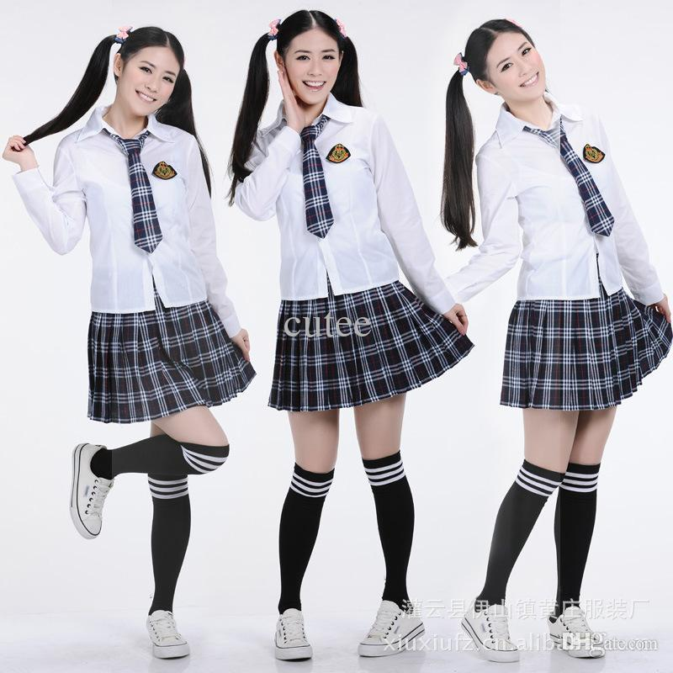
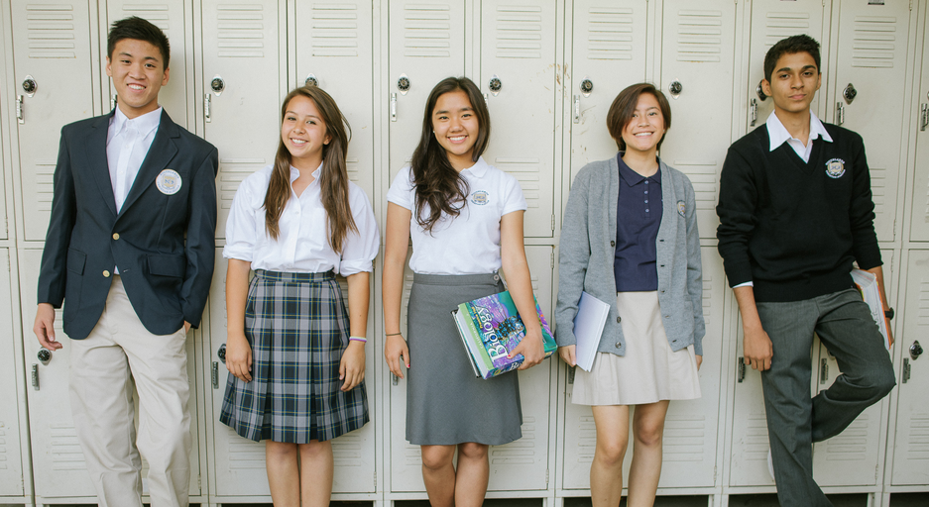

Slide 16
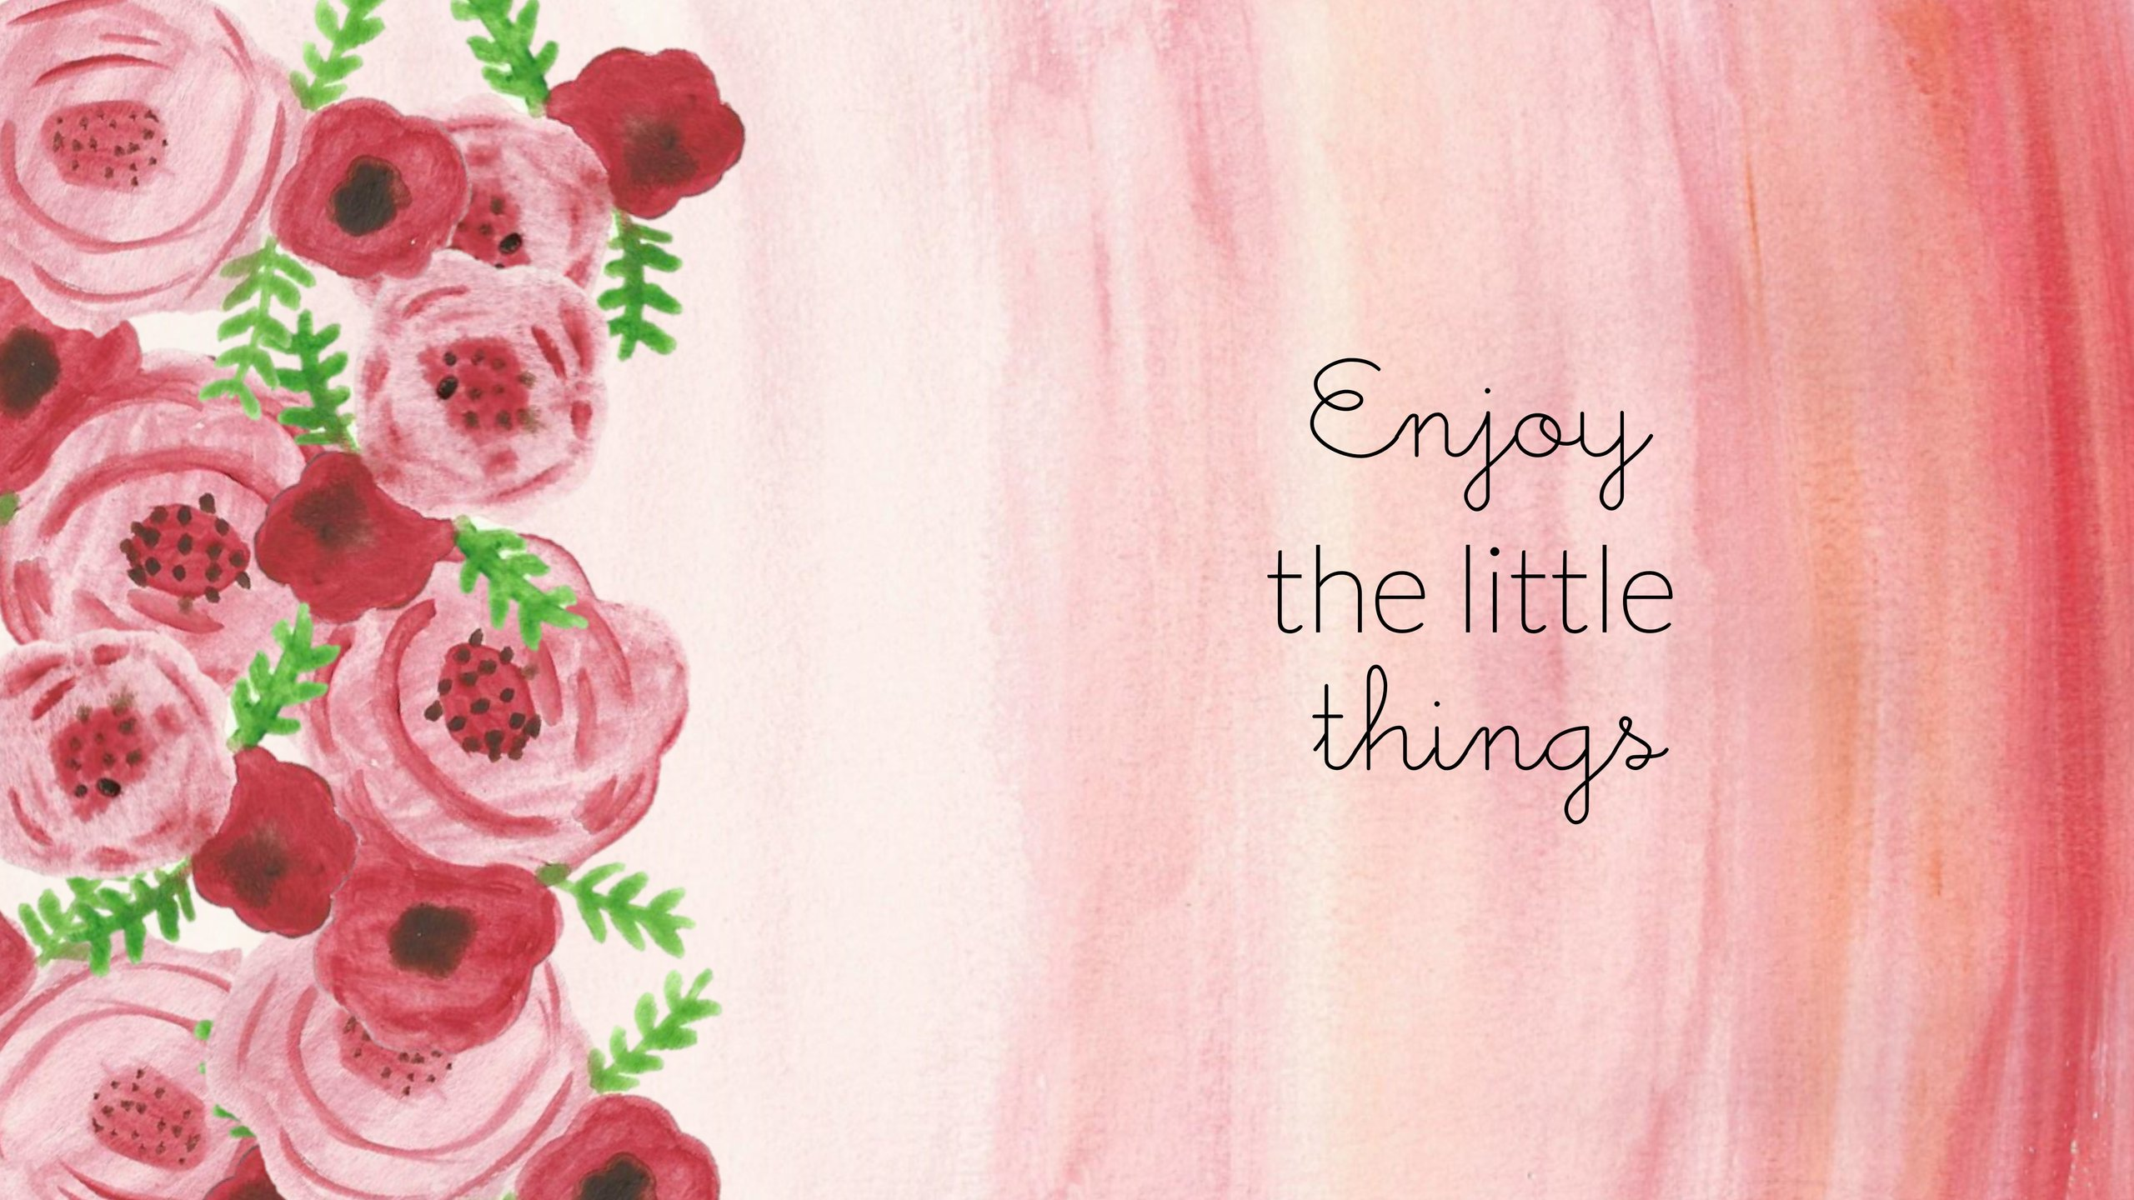
Thank you for attention

